Slide 1

Natural Language Processing
Yue Zhang
Westlake University

Slide 2
Chapter 7
Generative Sequence Labeling

Slide 3
Contents
7.1 Sequence Labelling
7.2 Hidden Markov Models
7.2.1 Training Hidden Markov Models
7.2.2 Decoding
7.3 Finding Marginal Probabilities
7.3.1 The Forward- Backward Algorithm
7.4 EM for Unsupervised HMM Training
7.4.1 EM for First-Order HMM

Slide 4
Contents
7.1 Sequence Labelling
7.2 Hidden Markov Models
7.2.1 Training Hidden Markov Models
7.2.2 Decoding
7.3 Finding Marginal Probabilities
7.3.1 The Forward- Backward Algorithm
7.4 EM for Unsupervised HMM Training
7.4.1 EM for First-Order HMM

Slide 5
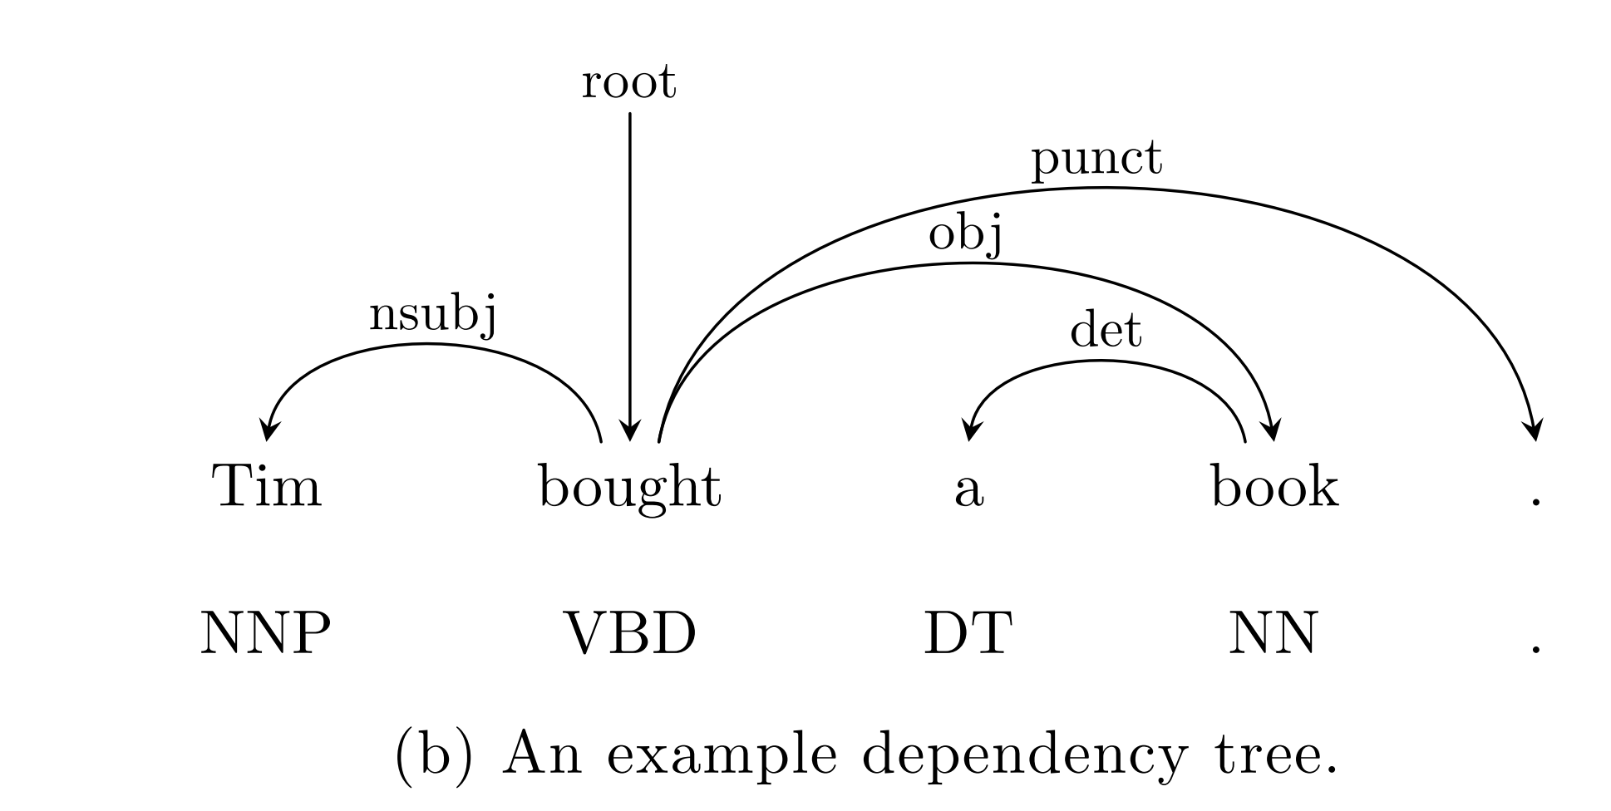
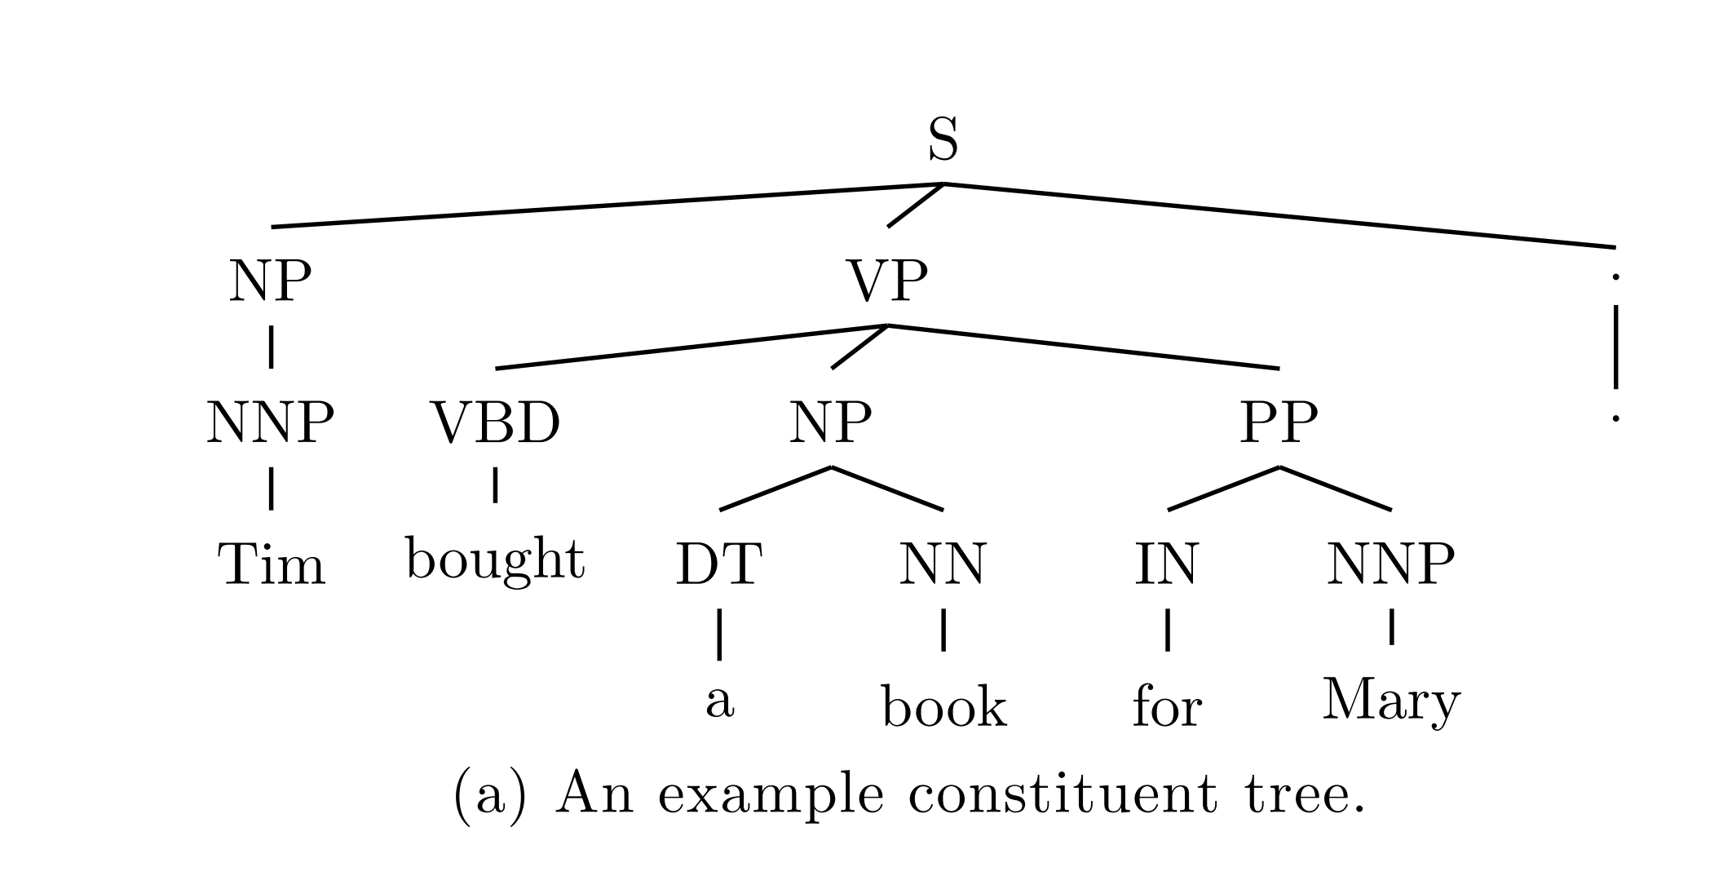
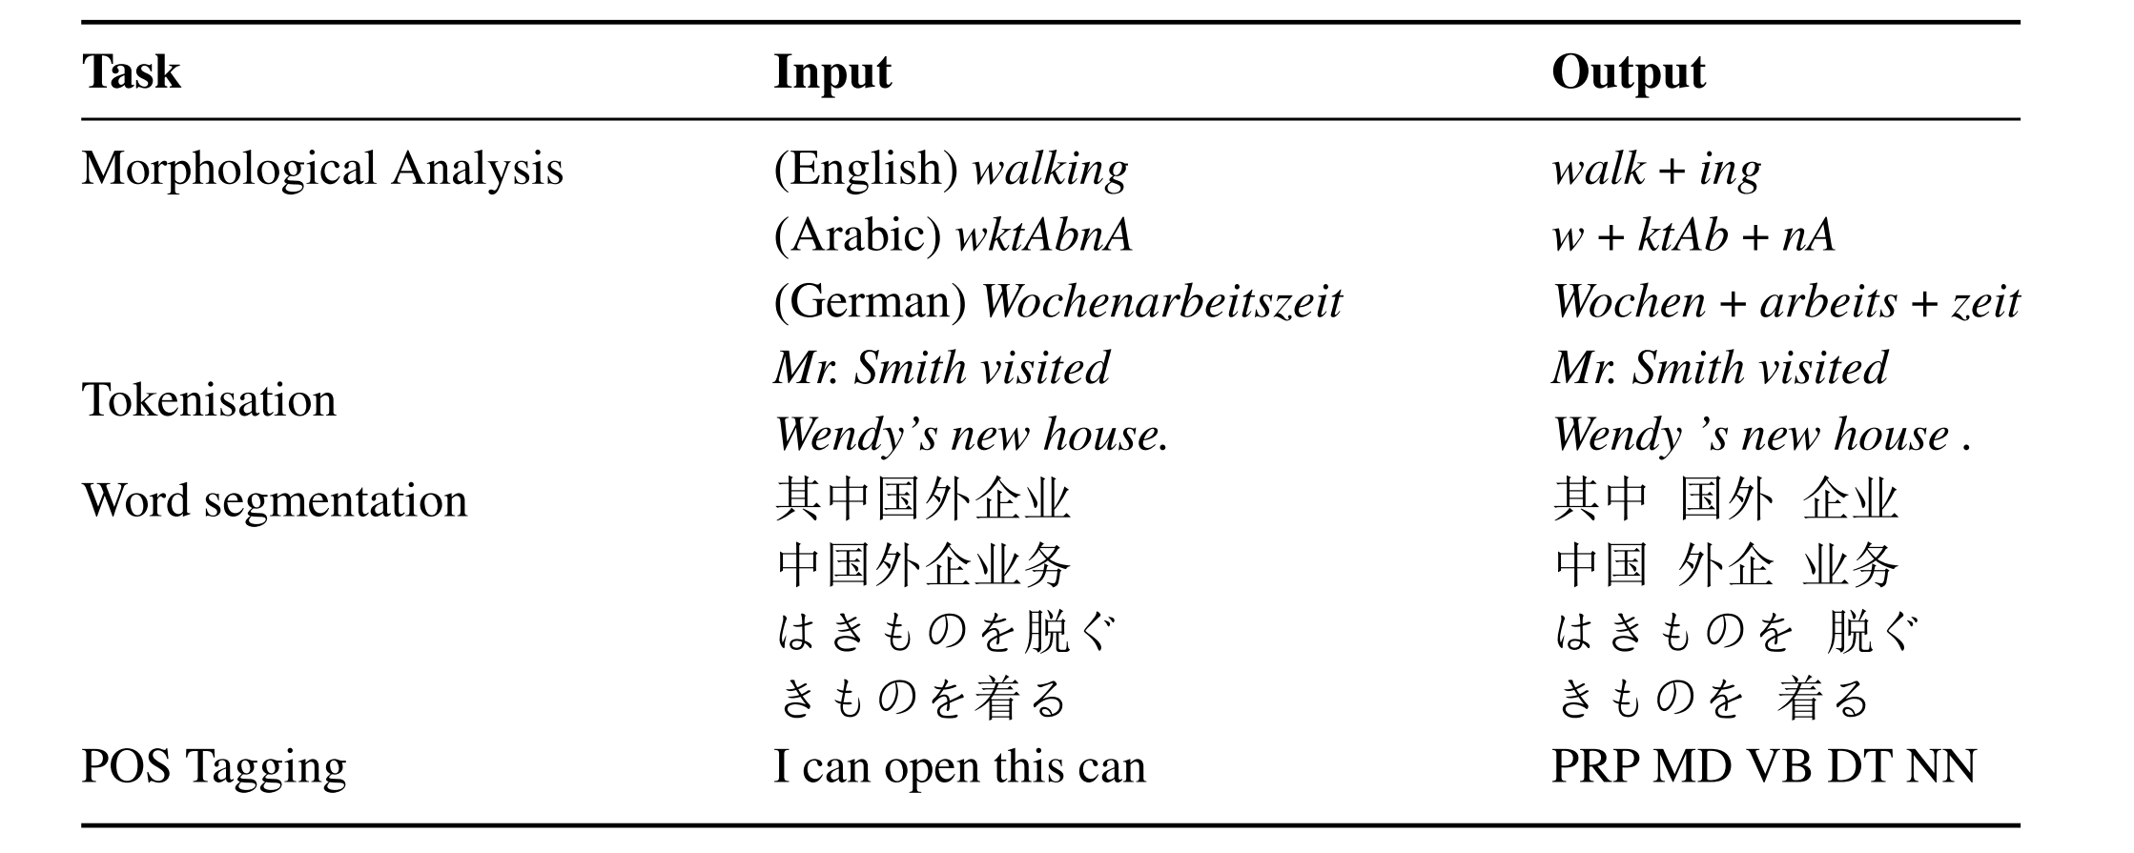
Structure Prediction
Output inter-dependency
Notes:
Figure error with row 1

Slide 6
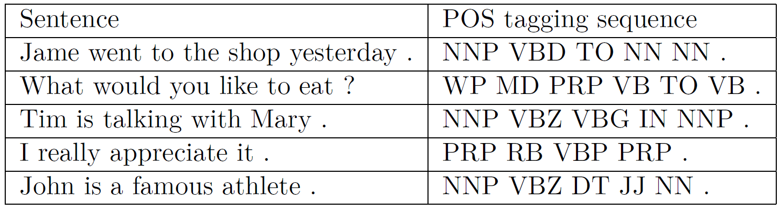
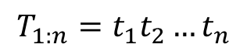
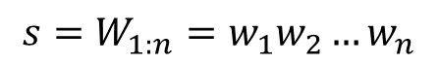
Sequence Labelling
Part-of-Speech tagging as example
Input is a sentence
Output is a sequence of POS tags
$$s=W_{1:n}=w_{1}w_{2}…w_{n}$$
$$T_{1:n}=t_{1}t_{2}…t_{n}$$
NNP：Proper Noun VBD：Verb, past tense TO: to NN: Noun
Notes:
Figure error with row 1

Slide 7
Sequence Labelling
Part-of-Speech tagging as example
Input is a sentence
Output is a sequence of POS tags
$$s=W_{1:n}=w_{1}w_{2}…w_{n}$$
$$T_{1:n}=t_{1}t_{2}…t_{n}$$
James went to the shop yesterday . NNP VBD TO DT NN NN .
James|NNP went|VBD to|TO the|DT park|NN yesterday|NN .|.
NNP：Proper Noun VBD：Verb, past tense TO: to NN: Noun
Notes:
Figure error with row 1

Slide 8
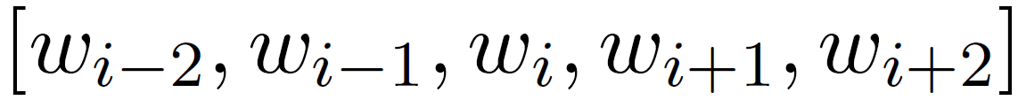
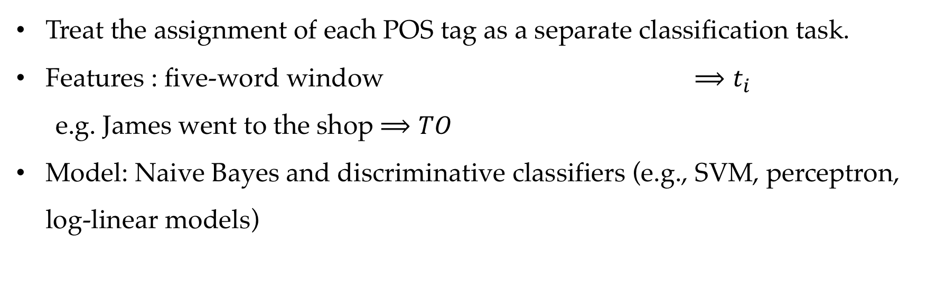
Local Model
Treat the assignment of each POS tag as a separate classification task.
Features : five-word window $⟹t_{i}$
e.g. James went to the shop $⟹TO$
Model: Naive Bayes and discriminative classifiers (e.g., SVM, perceptron, log-linear models)

Slide 9
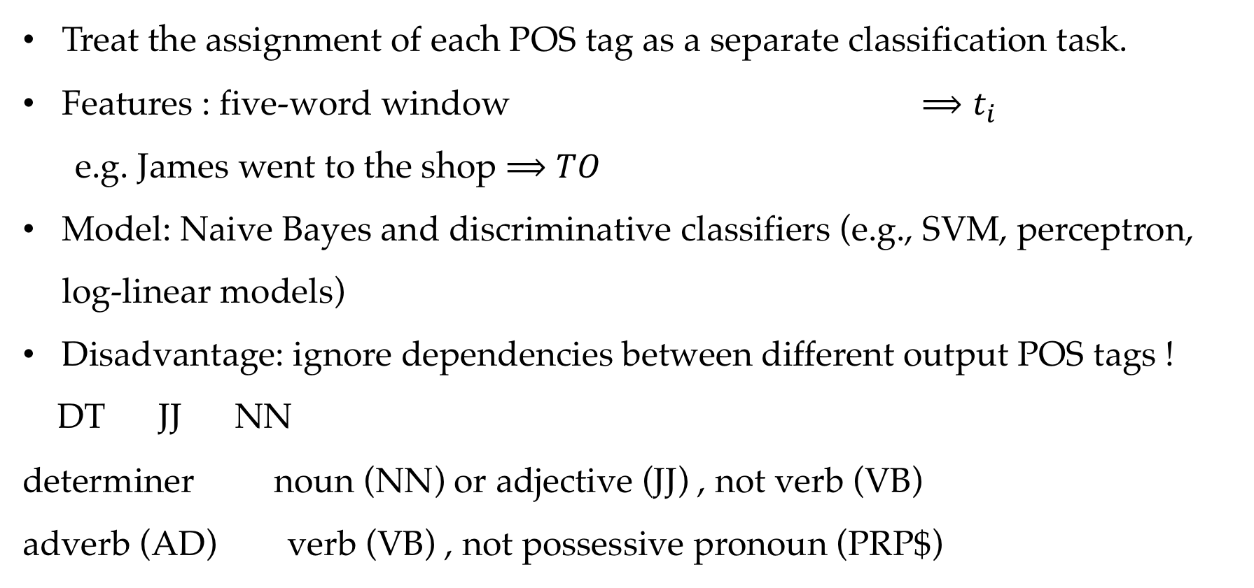
Local Model
Treat the assignment of each POS tag as a separate classification task.
Features : five-word window $⟹t_{i}$
e.g. James went to the shop $⟹TO$
Model: Naive Bayes and discriminative classifiers (e.g., SVM, perceptron, log-linear models)
Disadvantage: ignore dependencies between different output POS tags !
DT JJ NN
determiner noun (NN) or adjective (JJ) , not verb (VB)
adverb (AD) verb (VB) , not possessive pronoun (PRP$)

Slide 10
Contents
7.1 Sequence Labelling
7.2 Hidden Markov Models
7.2.1 Training Hidden Markov Models
7.2.2 Decoding
7.3 Finding Marginal Probabilities
7.3.1 The Forward- Backward Algorithm
7.4 EM for Unsupervised HMM Training
7.4.1 EM for First-Order HMM

Slide 11
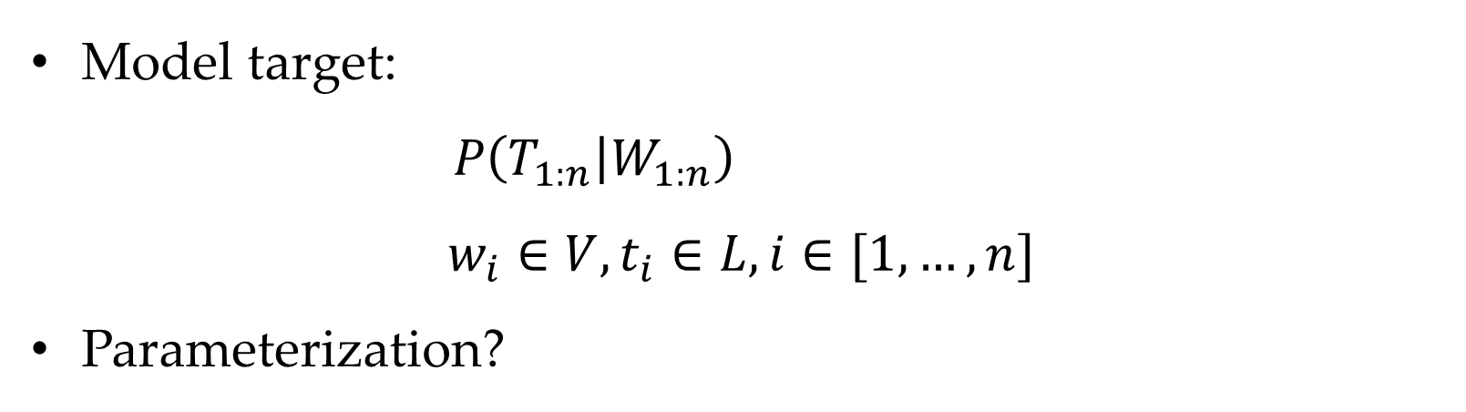
Model Target
Model target:
$P\left(T_{1:n} | W_{1:n}\right)$
$$w_{i}∈V,t_{i}∈L, i∈[1,…,n]$$
Parameterization?

Slide 12
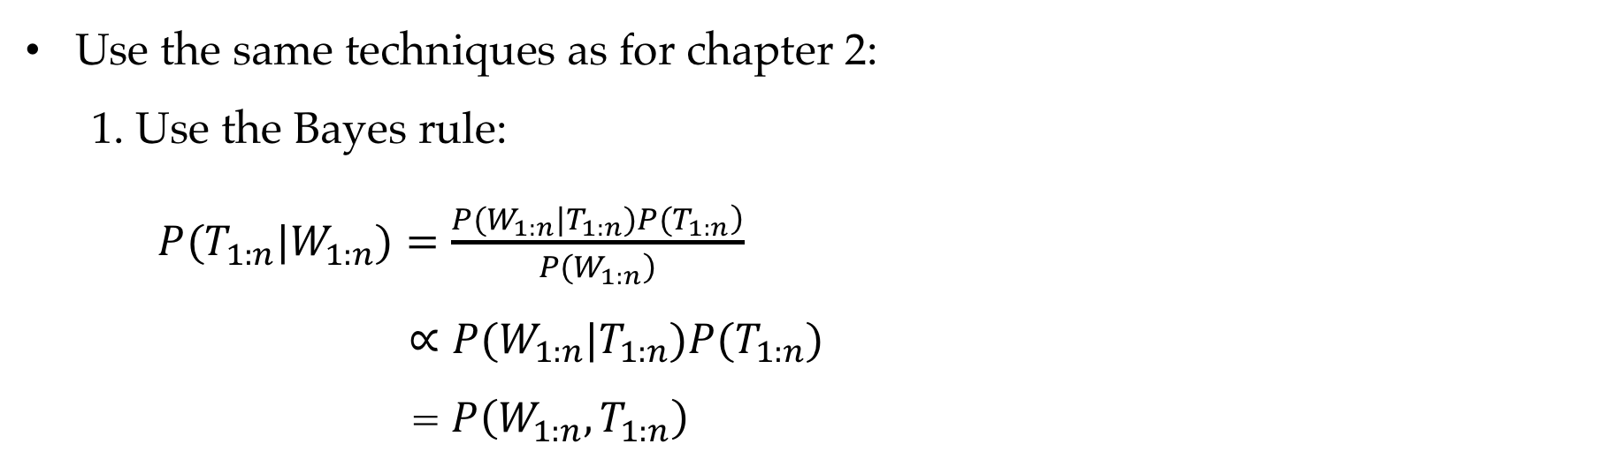
Structured Model
Use the same techniques as for chapter 2:
1. Use the Bayes rule:
$P(T_{1:n}|W_{1:n})=\frac{\left.P(W_{1:n}|T_{1:n})P(T_{1:n}\right)}{\left.P(W_{1:n}\right)}$
$∝P(W_{1:n}|T_{1:n})P(T_{1:n})$
= $P\left(W_{1:n},T_{1:n}\right)$

Slide 13
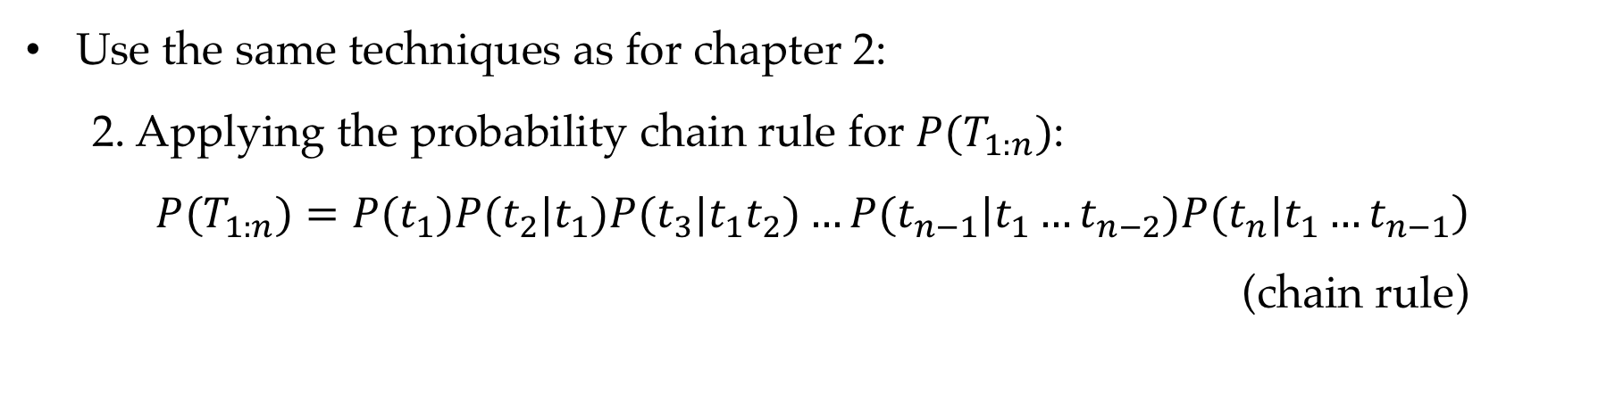
Structured Model
Use the same techniques as for chapter 2:
2. Applying the probability chain rule for $P(T_{1:n})$:
$$\left.P(T_{1:n})=P(t_{1})P(t_{2}|t_{1})P(t_{3}|t_{1}t_{2})…P(t_{n−1}|t_{1}…t_{n−2})P(t_{n}|t_{1}…t_{n−1}\right)$$
$$\text{(}\text{chain} \text{rule}\text{)}$$

Slide 14
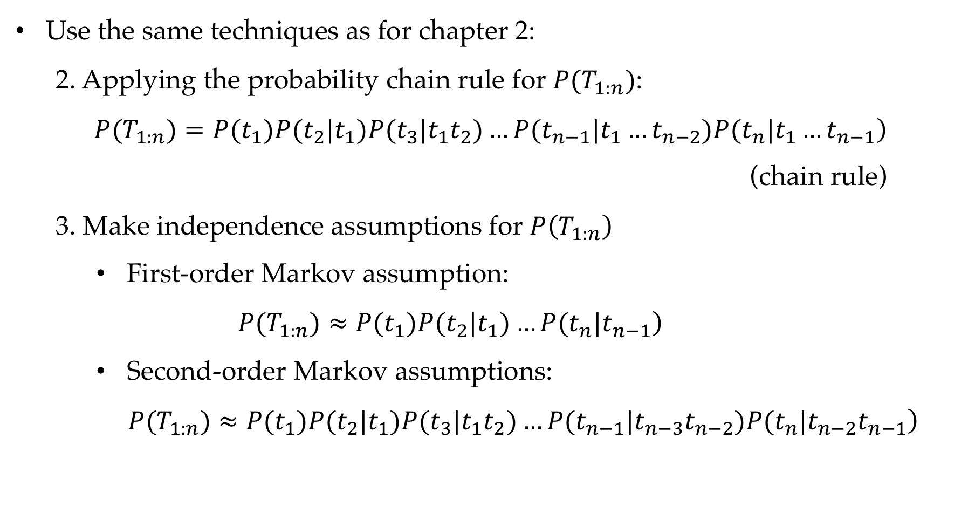
Structured Model
Use the same techniques as for chapter 2:
2. Applying the probability chain rule for $P(T_{1:n})$:
$$\left.P(T_{1:n})=P(t_{1})P(t_{2}|t_{1})P(t_{3}|t_{1}t_{2})…P(t_{n−1}|t_{1}…t_{n−2})P(t_{n}|t_{1}…t_{n−1}\right)$$
$\text{(}\text{chain} \text{rule}\text{)}$
3. Make independence assumptions for $P\left(T_{1:n}\right)$
First-order Markov assumption:
$$\left.P(T_{1:n})≈P(t_{1})P(t_{2}|t_{1})…P(t_{n}|t_{n−1}\right)$$
Second-order Markov assumptions:
$\left.P(T_{1:n})≈P(t_{1})P(t_{2}|t_{1})P(t_{3}|t_{1}t_{2})…P(t_{n−1}|t_{n−3}t_{n−2})P(t_{n}|t_{n−2}t_{n−1}\right)$

Slide 15
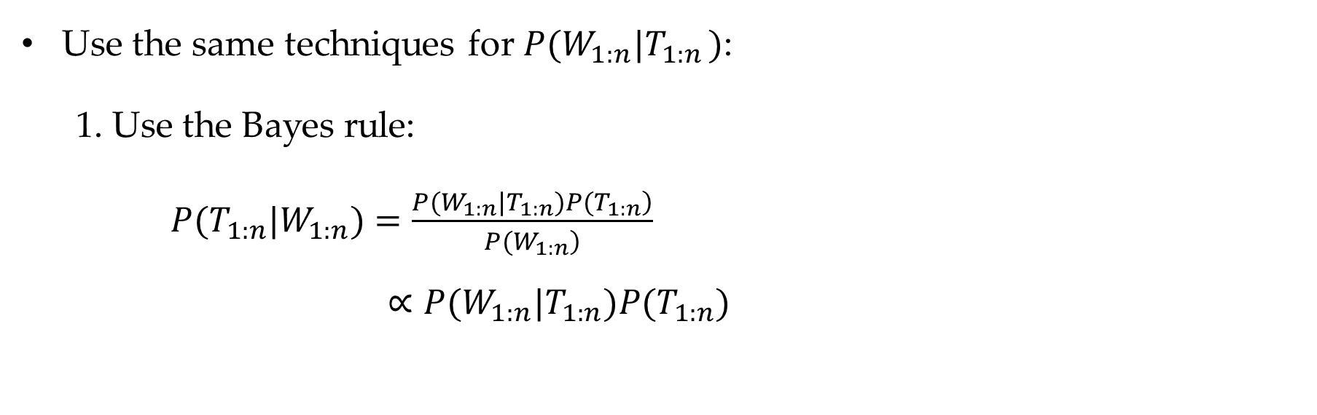
Structured Model
Use the same techniques for $P(W_{1:n}|T_{1:n })$:
1. Use the Bayes rule:
$P(T_{1:n}|W_{1:n})=\frac{\left.P(W_{1:n}|T_{1:n})P(T_{1:n}\right)}{\left.P(W_{1:n}\right)}$
$∝P(W_{1:n}|T_{1:n})P(T_{1:n})$

Slide 16
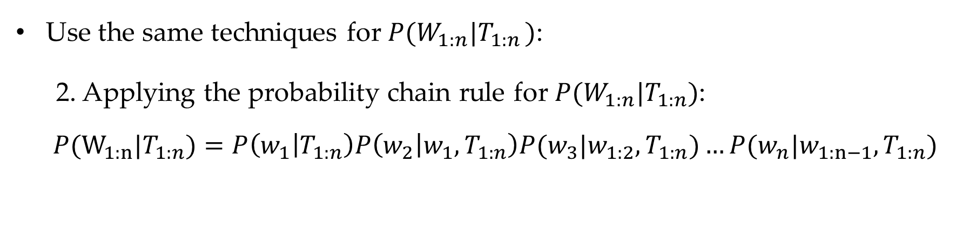
Structured Model
Use the same techniques for $P(W_{1:n}|T_{1:n })$:
2. Applying the probability chain rule for $P(W_{1:n}|T_{1:n})$:
$P(W_{1:n}|T_{1:n})=P\left(w_{1} | T_{1:n}\right)P\left(w_{2} | w_{1},T_{1:n}\right)P(w_{3}|w_{1:2},T_{1:n})…P(w_{n}|w_{1:n−1}, T_{1:n})$

Slide 17
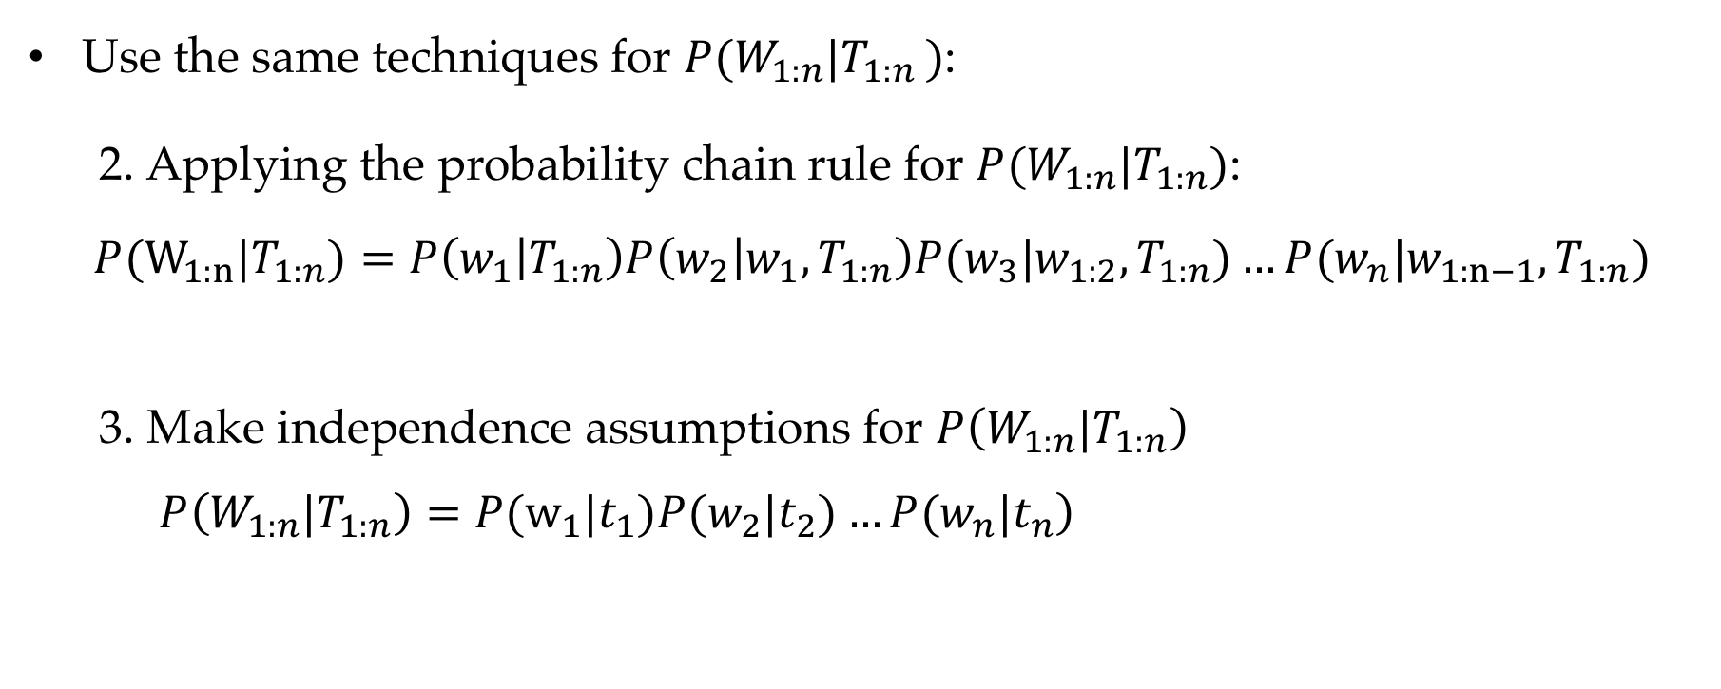
Structured Model
Use the same techniques for $P(W_{1:n}|T_{1:n })$:
2. Applying the probability chain rule for $P(W_{1:n}|T_{1:n})$:
$P(W_{1:n}|T_{1:n})=P\left(w_{1} | T_{1:n}\right)P\left(w_{2} | w_{1},T_{1:n}\right)P(w_{3}|w_{1:2},T_{1:n})…P(w_{n}|w_{1:n−1}, T_{1:n})$
3. Make independence assumptions for $P\left(W_{1:n}|T_{1:n}\right)$
$\left.P\left({W_{1:n}|T}_{1:n}\right)=P(w_{1}|t_{1})P(w_{2}|t_{2})…P(w_{n}|t_{n}\right)$

Slide 18
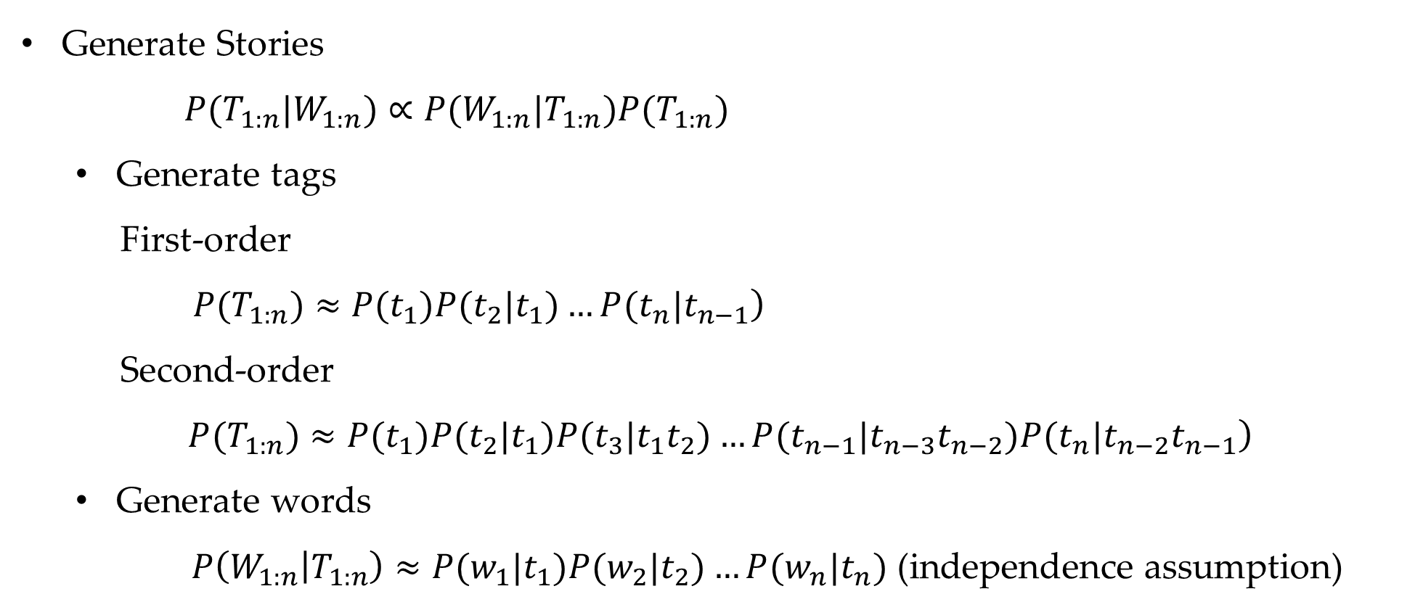
Structured Model
Generate Stories
$P(T_{1:n}|W_{1:n})∝P(W_{1:n}|T_{1:n})P(T_{1:n})$
Generate tags
First-order
$\left.P(T_{1:n})≈P(t_{1})P(t_{2}|t_{1})…P(t_{n}|t_{n−1}\right)$
Second-order
$$\left. P(T_{1:n})≈P(t_{1})P(t_{2}|t_{1})P(t_{3}|t_{1}t_{2})…P(t_{n−1}|t_{n−3}t_{n−2})P(t_{n}|t_{n−2}t_{n−1}\right)$$
Generate words
$P\left(W_{1:n} | T_{1:n}\right)≈P(w_{1}|t_{1})P(w_{2}|t_{2})…P(w_{n}|t_{n}) \text{(}\text{independence} \text{assumption}\text{)}$
Notes:
Emission & transition

Slide 19
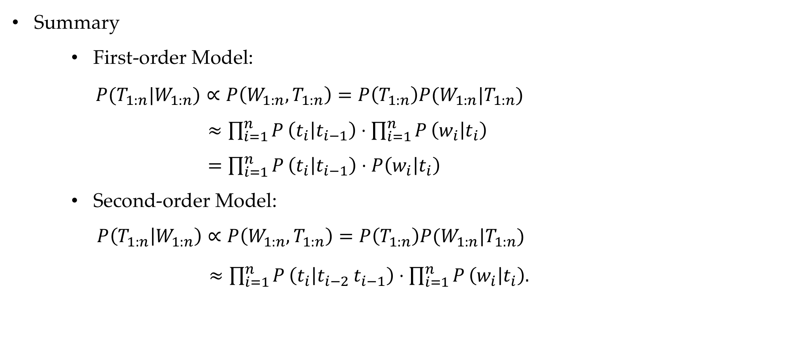
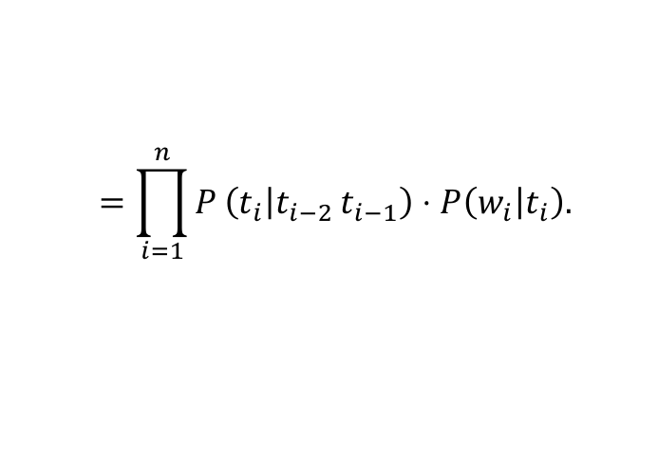
Structured Model
Summary
First-order Model:
$P(T_{1:n}|W_{1:n})∝P\left(W_{1:n},T_{1:n}\right)=P\left(T_{1:n}\right)P(W_{1:n}|T_{1:n})$
$≈\prod_{i=1}^{n}{P}\left(t_{i} | t_{i−1}\right)⋅\prod_{i=1}^{n}{P}\left(w_{i} | t_{i}\right)$
$=\prod_{i=1}^{n}{P}\left(t_{i} | t_{i−1}\right)⋅P\left(w_{i} | t_{i}\right)$
Second-order Model:
$P\left(T_{1:n} | W_{1:n}\right)∝P\left(W_{1:n},T_{1:n}\right)=P\left(T_{1:n}\right)P(W_{1:n}|T_{1:n})$
$≈\prod_{i=1}^{n}{P}\left(t_{i} | t_{i−2} t_{i−1}\right)⋅\prod_{i=1}^{n}{P}\left(w_{i} | t_{i}\right).$
$$=\prod_{i=1}^{n}{P}\left(t_{i} | t_{i−2} t_{i−1}\right)⋅P\left(w_{i} | t_{i}\right).$$
Notes:
Emission & transition

Slide 20
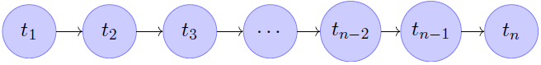
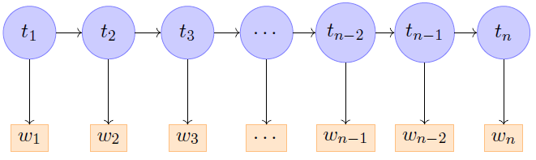
Structured Model
A generative model. Use first-order HMM as an example.
First generate tags such as “NNP (proper noun) VBZ (verb third-person singular) NN(noun)”
Then filling the words such as “Jim reads thrillers”.

Slide 21
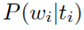
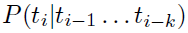
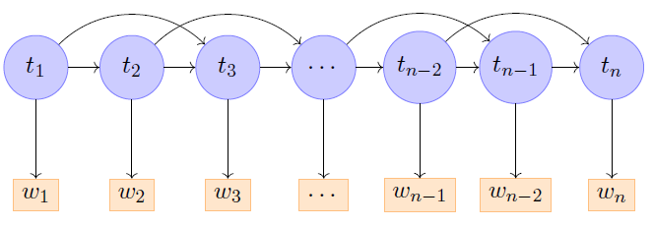
Structured Model
First-order Model:
Second-order Model:
Emission probability:
Transition probability:

Slide 22
Contents
7.1 Sequence Labelling
7.2 Hidden Markov Models
7.2.1 Training Hidden Markov Models
7.2.2 Decoding
7.3 Finding Marginal Probabilities
7.3.1 The Forward- Backward Algorithm
7.4 EM for Unsupervised HMM Training
7.4.1 EM for First-Order HMM

Slide 23
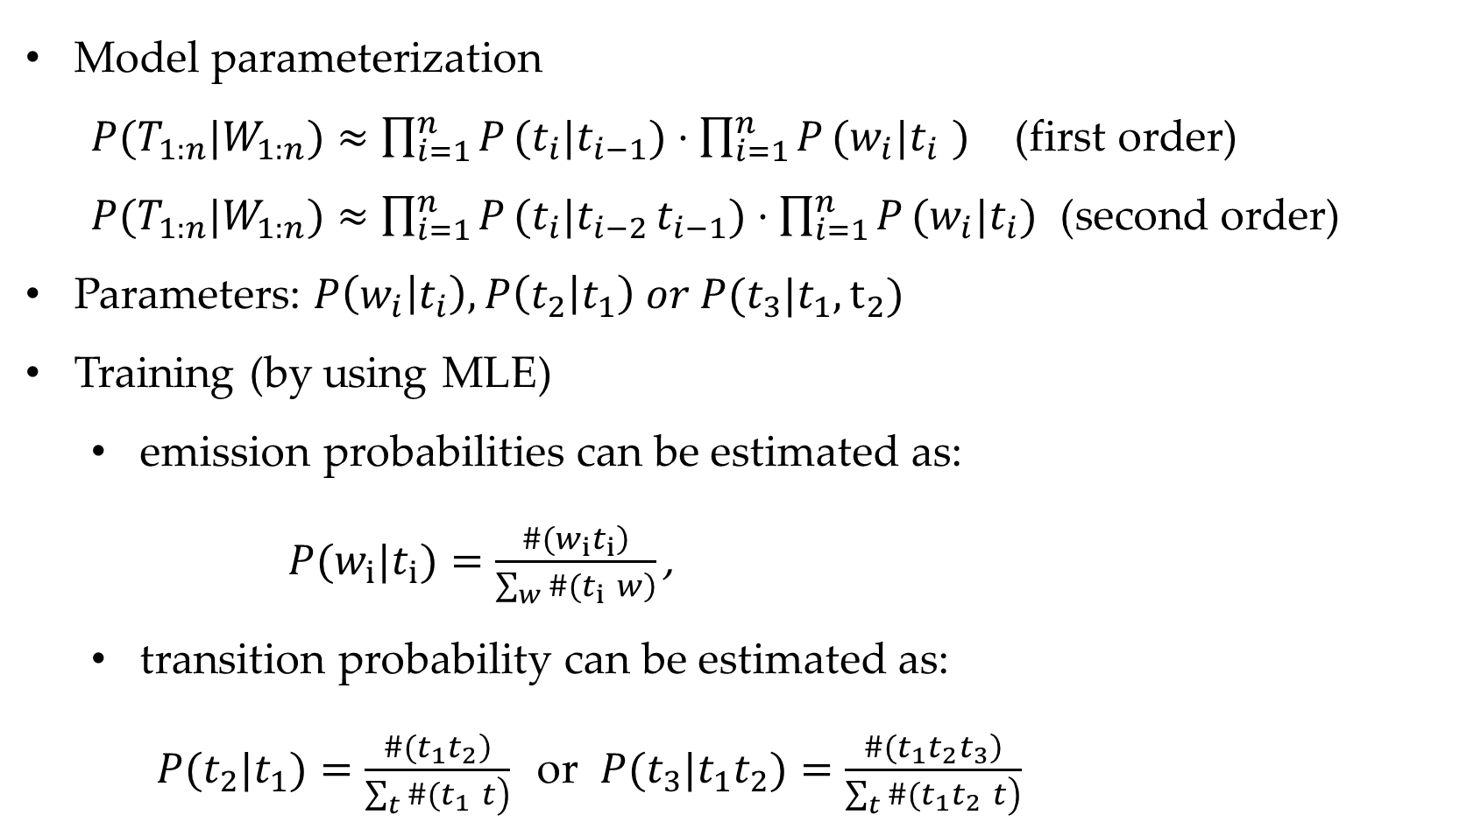
Hidden Markov Model
Model parameterization
$P(T_{1:n}|W_{1:n})≈\prod_{i=1}^{n}{P}(t_{i}|t_{i−1})⋅\prod_{i=1}^{n}{P}(w_{i}|t_{i}$ $)$ (first order) $P(T_{1:n}|W_{1:n})≈\prod_{i=1}^{n}{P}(t_{i}|t_{i−2} t_{i−1})⋅\prod_{i=1}^{n}{P}(w_{i}|t_{i})$ (second order)
Parameters: $P\left(w_{i} | t_{i}\right), P\left(t_{2} | t_{1}\right) or P(t_{3}|t_{1},t_{2})$
Training (by using MLE)
emission probabilities can be estimated as:
$P(w_{i}|t_{i})=\frac{\left.\#(w_{i}t_{i}\right)}{\left.\sum_{w}{\#}(t_{i} w\right)}\text{,}$
transition probability can be estimated as:
$P(t_{2}|t_{1})=\frac{\left.\#(t_{1}t_{2}\right)}{\left.\sum_{t}{\#}(t_{1} t\right)}$or $P(t_{3}|t_{1}t_{2})=\frac{\left.\#(t_{1}t_{2}t_{3}\right)}{\left.\sum_{t}{\#}(t_{1}t_{2} t\right)}$
Notes:
Equation error

Slide 24
Contents
7.1 Sequence Labelling
7.2 Hidden Markov Models
7.2.1 Training Hidden Markov Models
7.2.2 Decoding
7.3 Finding Marginal Probabilities
7.3.1 The Forward- Backward Algorithm
7.4 EM for Unsupervised HMM Training
7.4.1 EM for First-Order HMM

Slide 25
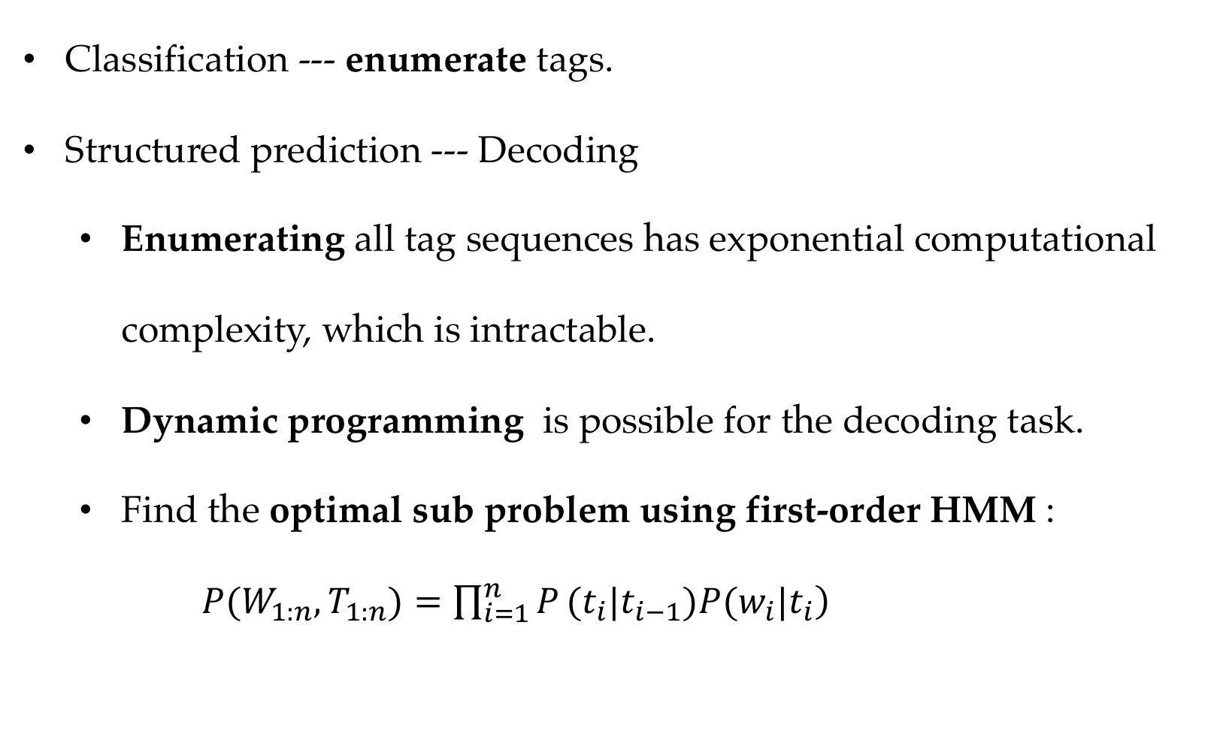
Hidden Markov Model
Classification --- enumerate tags.
Structured prediction --- Decoding
Enumerating all tag sequences has exponential computational complexity, which is intractable.
Dynamic programming is possible for the decoding task.
Find the optimal sub problem using first-order HMM :
$\left.P(W_{1:n},T_{1:n})=\prod_{i=1}^{n}{P}(t_{i}|t_{i−1})P(w_{i}|t_{i}\right)$

Slide 26
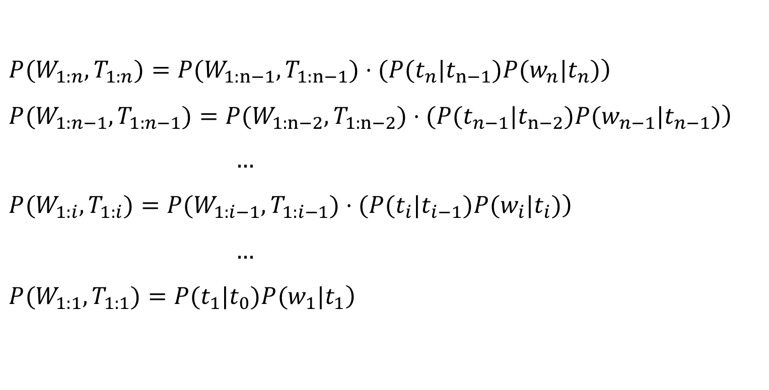
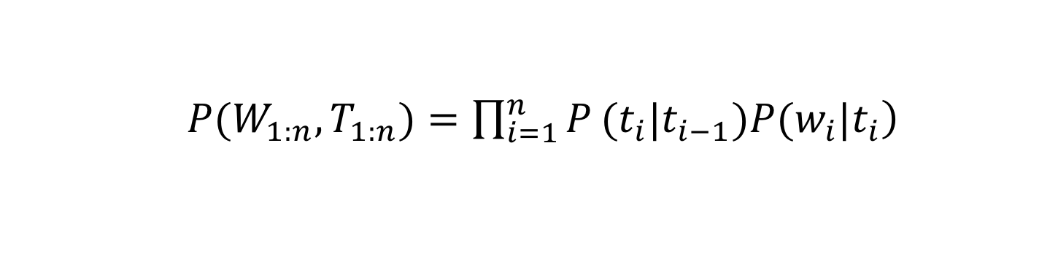
Hidden Markov Model
$\left.P(W_{1:n},T_{1:n})=\prod_{i=1}^{n}{P}(t_{i}|t_{i−1})P(w_{i}|t_{i}\right)$
$\left.P(W_{1:n},T_{1:n})=P(W_{1:n−1},T_{1:n−1})⋅(P(t_{n}|t_{n−1})P(w_{n}|t_{n})\right)$
$\left.P(W_{1:n−1},T_{1:n−1})=P(W_{1:n−2},T_{1:n−2})⋅(P(t_{n−1}|t_{n−2})P(w_{n−1}|t_{n−1})\right)$
$…$
$\left.P(W_{1:i},T_{1:i})=P(W_{1:i−1},T_{1:i−1})⋅(P(t_{i}|t_{i−1})P(w_{i}|t_{i})\right)$
$…$
$\left.P(W_{1:1},T_{1:1})=P(t_{1}|t_{0})P(w_{1}|t_{1}\right)$

Slide 27
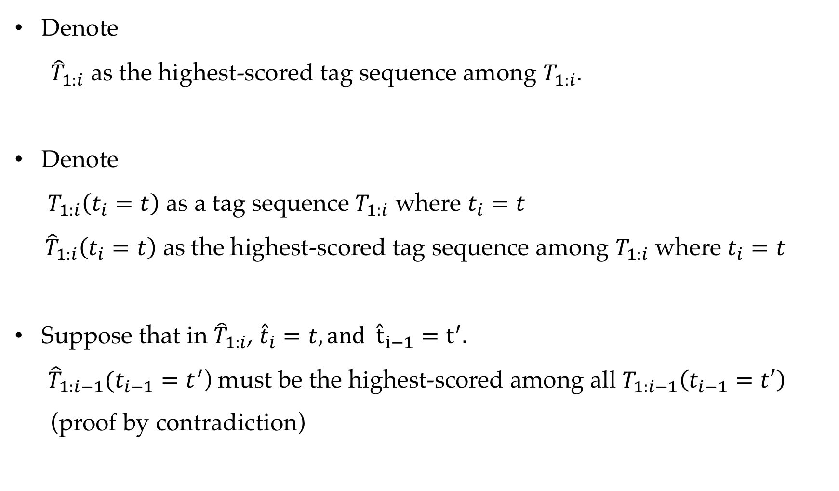
Hidden Markov Model
Denote
${\hat{T}}_{1:i}$ as the highest-scored tag sequence among $T_{1:i}.$
Denote $T_{1:i}\left(t_{i}=t\right)$ as a tag sequence $T_{1:i}$ where $t_{i}=t$
${\hat{T}}_{1:i}\left(t_{i}=t\right)$ as the highest-scored tag sequence among $T_{1:i}$ where $t_{i}=t$
Suppose that in ${\hat{T}}_{1:i}$, ${\hat{t}}_{i}=t, and {\hat{t}}_{i−1}=t^{′}.$
${\hat{T}}_{1:i−1}(t_{i−1}=t^{′}$) must be the highest-scored among all $T_{1:i−1}\left(t_{i−1}=t′\right)$ (proof by contradiction)

Slide 28
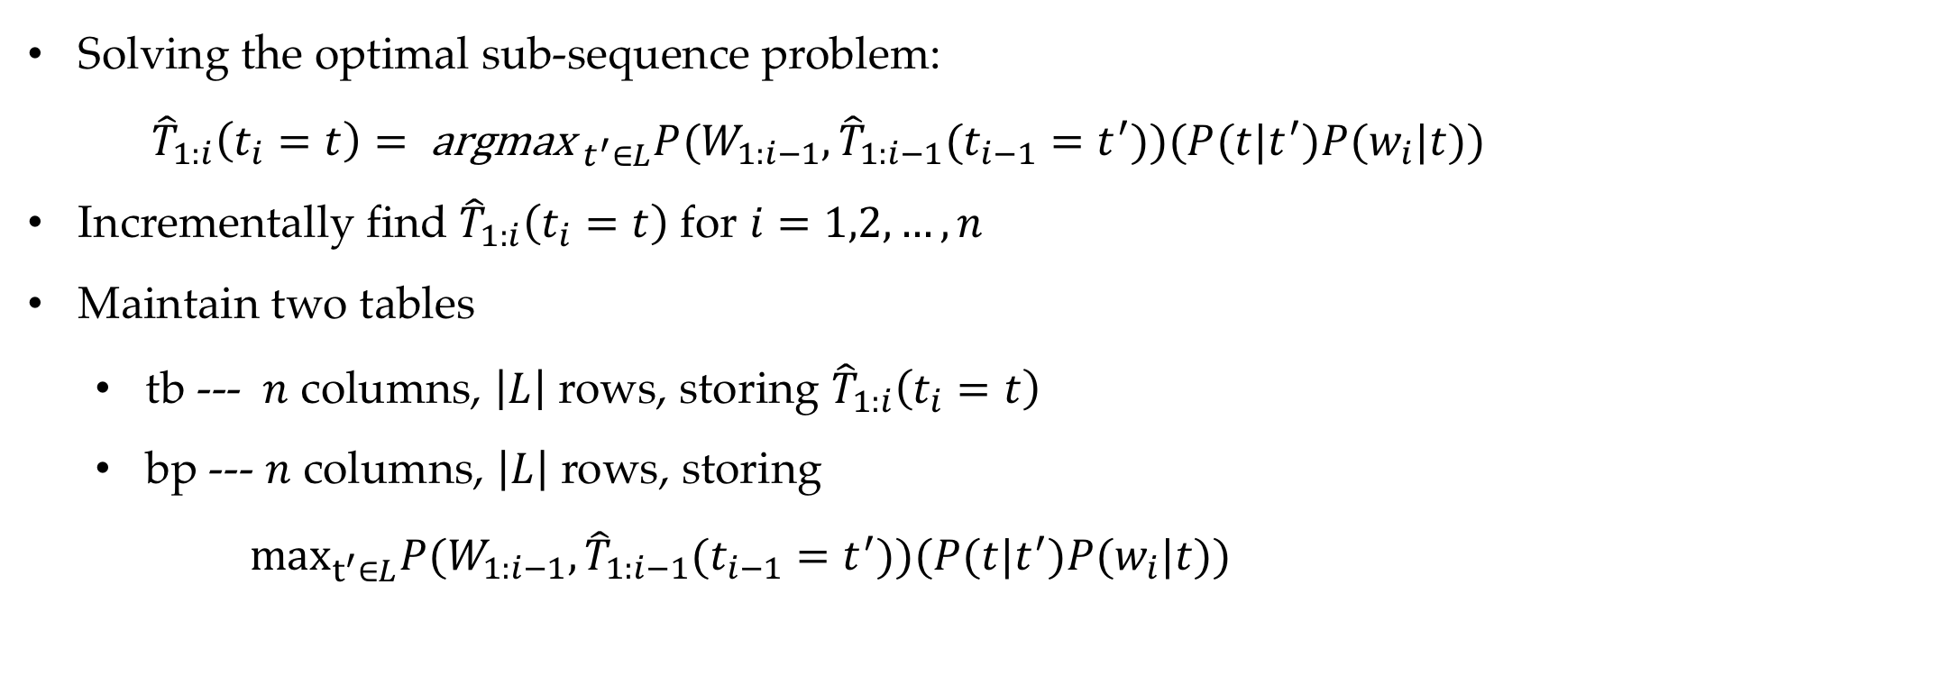
Hidden Markov Model
Solving the optimal sub-sequence problem:
${\hat{T}}_{1:i}\left(t_{i}=t\right)={ \text{argmax}}_{ t^{′}∈L}P(W_{1:i−1},{\hat{T}}_{1:i−1}(t_{i−1}=t^{′}))(P(t|t^{′})P(w_{i}|t))$
Incrementally find ${\hat{T}}_{1:i}\left(t_{i}=t\right)$ for $i=1,2,…,n$
Maintain two tables
tb --- $n$ columns, $\left|L\right|$ rows, storing ${\hat{T}}_{1:i}\left(t_{i}=t\right)$
bp --- $n$ columns, $\left|L\right|$ rows, storing
$\max_{t^{′}∈L}P(W_{1:i−1},{\hat{T}}_{1:i−1}(t_{i−1}=t^{′}))(P(t|t^{′})P(w_{i}|t))$

Slide 29
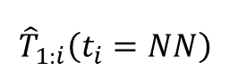
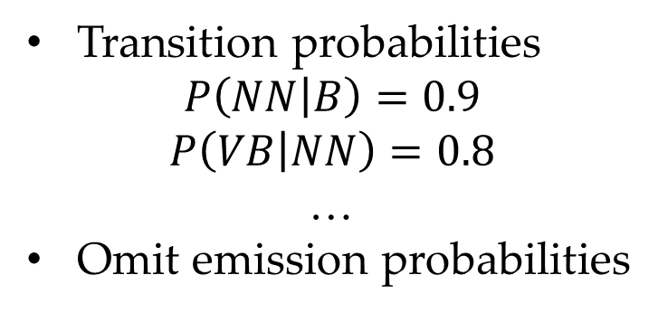
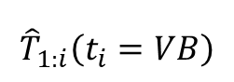
Hidden Markov Model
An example (adding <B> in the beginning)
Find the path with the highest probability.
People like books
tb table
bp table
NN
0.2
NN
0.2
NN
$${\hat{T}}_{1:i}\left(t_{i}=NN\right)$$
1 | 0 | 0 | 0
1 | 0 | 0 | 0
NULL
NULL
0.9
0.8
0.8
B
$${\hat{T}}_{1:i}\left(t_{i}=VB\right)$$
0.6
0.6
0.1
VB
VB
VB
0 1 2 3
0.4
0.4
Transition probabilities
$$P\left(NN | B\right)=0.9$$
$$P\left(VB | NN\right)=0.8$$
…
Omit emission probabilities

Slide 30
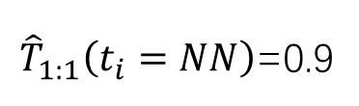
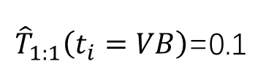
Hidden Markov Model
An example (adding <B> in the beginning)
Find the path with the highest probability.
People like books
tb table
bp table
NN
0.2
NN
0.2
NN
1 | 0 | 0 | 0
1 | 0 | 0 | 0
NULL
NULL
0.9
0.8
0.8
B
0.1
VB
0.6
VB
0.6
VB
0.4
0.4
1 | 0.9 | 0 | 0
1 | 0.1 | 0 | 0
NULL | B
NULL | B
${\hat{T}}_{1:1}\left(t_{i}=NN\right)$=0.9
${\hat{T}}_{1:1}\left(t_{i}=VB\right)$=0.1

Slide 31
Hidden Markov Model
An example (adding <B> in the beginning)
Find the path with the highest probability.
People like books
tb table
bp table
NN
0.2
NN
0.2
NN
1 | 0 | 0 | 0
1 | 0 | 0 | 0
NULL
NULL
0.9
0.8
0.8
B
0.1
VB
0.6
VB
0.6
VB
0.4
0.4
1 | 0.9 | 0 | 0
1 | 0.1 | 0 | 0
NULL | B
NULL | B
1 | 0.9 | 0.9*0.2 0.1*0.6 | 0
1 | 0.1 | 0.9*0.8 0.1*0.4 | 0
NULL | B | NN
NULL | B | NN
${\hat{T}}_{1:2}\left(t_{2}=NN\right)$=0.9*0.2=0.18 (NN NN > VB NN)
${\hat{T}}_{1:2}\left(t_{2}=VB\right)$=0.9*0.8=0.72 (NN VB > VB VB)

Slide 32
Hidden Markov Model
An example (adding <B> in the beginning)
Find the path with the highest probability.
People like books
tb table
bp table
NN
0.2
NN
0.2
NN
1 | 0 | 0 | 0
1 | 0 | 0 | 0
NULL
NULL
0.9
0.8
0.8
B
0.1
VB
0.6
VB
0.6
VB
0.4
0.4
1 | 0.9 | 0 | 0
1 | 0.1 | 0 | 0
NULL | B
NULL | VB
1 | 0.9 | 0.9*0.2 0.1*0.6 | 0
1 | 0.1 | 0.9*0.8 0.1*0.4 | 0
NULL | B | NN
NULL | B | NN
1 | 0.9 | 0.18 | 0.18*0.2 0.72*0.6
1 | 0.1 | 0.72 | 0.18*0.8 0.72*0.4
NULL | B | NN | VB
NULL | B | NN | VB
(NNN NN NN < NN VB NN) (NN NN VB < NN VB VB)

Slide 33
Hidden Markov Model
An example (adding <B> in the beginning)
Find the path with the highest probability.
tb table
bp table
1 | 0 | 0 | 0
1 | 0 | 0 | 0
NULL
NULL
People like books
NN
0.2
NN
0.2
NN
0.9
0.8
0.8
B
1 | 0.9 | 0 | 0
1 | 0.1 | 0 | 0
NULL | B
NULL | B
0.1
VB
0.6
VB
0.6
VB
0.4
0.4
1 | 0.9 | 0.9*0.2 0.1*0.6 | 0
1 | 0.1 | 0.9*0.8 0.1*0.4 | 0
NULL | B | NN
NULL | B | NN
1 | 0.9 | 0.18 | 0.18*0.2 0.72*0.6
1 | 0.1 | 0.72 | 0.18*0.8 0.72*0.4
NULL | B | NN | VB
NULL | B | NN | VB
1 | 0.9 | 0.18 | 0.432
1 | 0.1 | 0.72 | 0.288
NULL | B | NN | VB
NULL | B | NN | VB
(NN VB NN > NN VB VB)

Slide 34
Hidden Markov Model
An example (adding <B> in the beginning)
Find the path with the highest probability.
tb table
bp table
1 | 0 | 0 | 0
1 | 0 | 0 | 0
NULL
NULL
People like books
NN
0.2
NN
0.2
NN
0.9
0.8
0.8
B
1 | 0.9 | 0 | 0
1 | 0.1 | 0 | 0
NULL | B
NULL | B
0.1
VB
0.6
VB
0.6
VB
0.4
0.4
1 | 0.9 | 0.9*0.2 0.1*0.6 | 0
1 | 0.1 | 0.9*0.8 0.1*0.4 | 0
NULL | B | NN
NULL | B | NN
1 | 0.9 | 0.18 | 0.18*0.2 0.72*0.6
1 | 0.1 | 0.72 | 0.18*0.8 0.72*0.4
NULL | B | NN | VB
NULL | B | NN | VB
People like books
NN
0.2
NN
0.2
NN
1 | 0.9 | 0.18 | 0.432
1 | 0.1 | 0.72 | 0.288
NULL | B | NN | VB
NULL | B | NN | VB
0.9
0.8
0.8
B
0.1
VB
0.6
VB
0.6
VB
0.4
0.4

Slide 35
Hidden Markov Model
An example (adding <B> in the beginning)
Find the path with the highest probability.
tb table
bp table
People like books
1 | 0 | 0 | 0
1 | 0 | 0 | 0
NULL
NULL
NN
0.2
NN
0.2
NN
0.9
0.8
0.8
B
1 | 0.9 | 0 | 0
1 | 0.1 | 0 | 0
NULL | B
NULL | B
0.1
VB
0.6
VB
0.6
VB
0.4
0.4
1 | 0.9 | 0.9*0.2 0.1*0.6 | 0
1 | 0.1 | 0.9*0.8 0.1*0.4 | 0
NULL | B | NN
NULL | B | NN
1 | 0.9 | 0.18 | 0.18*0.2 0.72*0.6
1 | 0.1 | 0.72 | 0.18*0.8 0.72*0.4
NULL | B | NN | VB
NULL | B | NN | VB
People like books
NN
0.2
NN
0.2
NN
1 | 0.9 | 0.18 | 0.432
1 | 0.1 | 0.72 | 0.288
NULL | B | NN | VB
NULL | B | NN | VB
0.9
0.8
0.8
B
0.1
VB
0.6
VB
0.6
VB
0.4
0.4

Slide 36
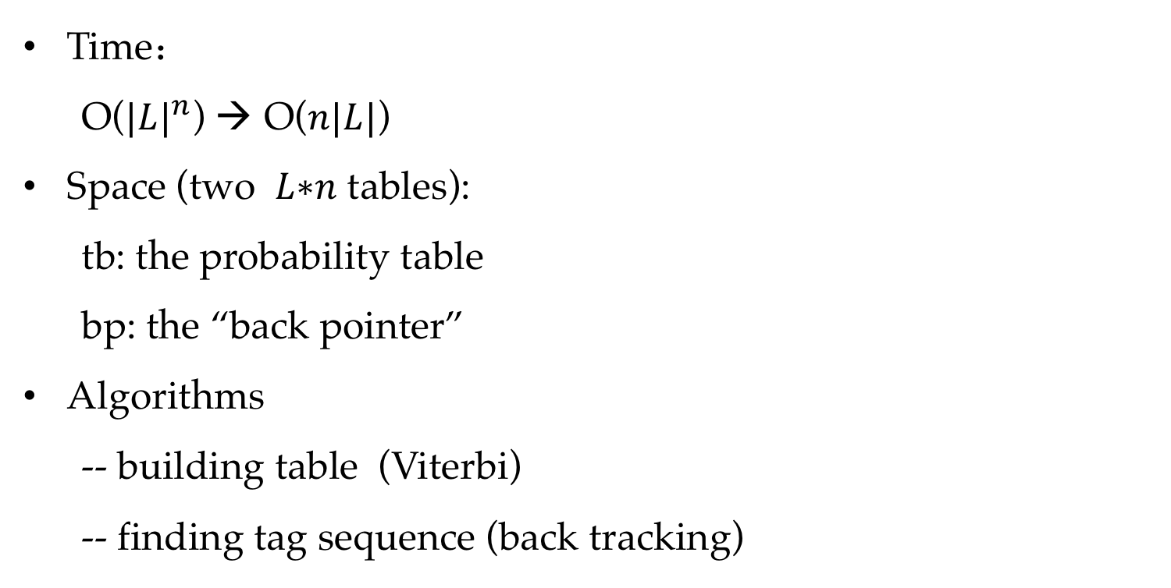
Hidden Markov Model
Time：
O(${|L|}^{n}$) → O($n|L|$)
Space (two 𝐿∗𝑛 tables):
tb: the probability table
bp: the “back pointer”
Algorithms
-- building table (Viterbi)
-- finding tag sequence (back tracking)

Slide 37
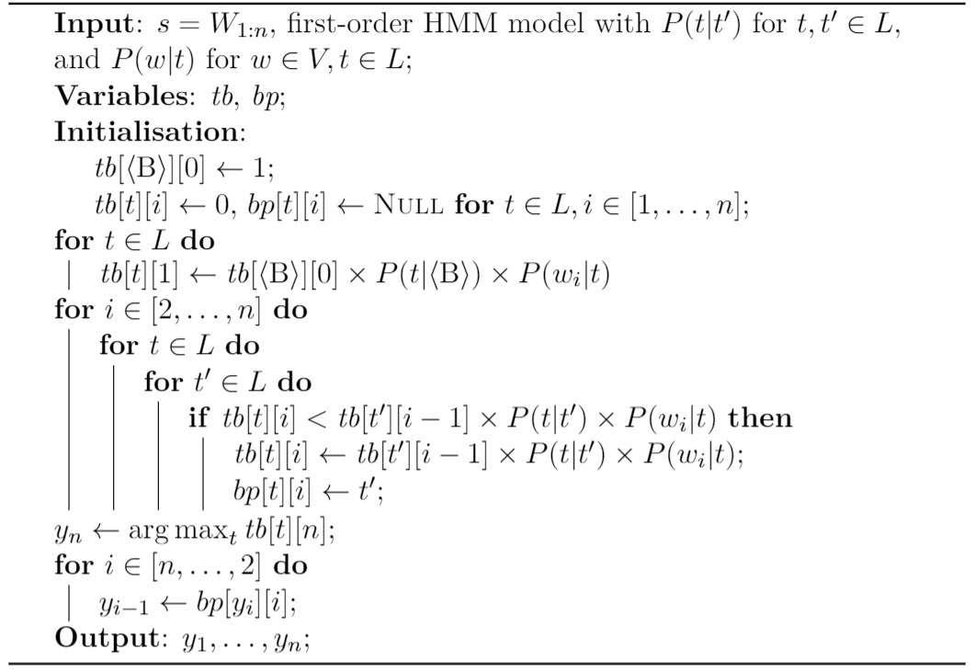
Hidden Markov Model
Decoding

Slide 38
Contents
7.1 Sequence Labelling
7.2 Hidden Markov Models
7.2.1 Training Hidden Markov Models
7.2.2 Decoding
7.3 Finding Marginal Probabilities
7.3.1 The Forward- Backward Algorithm
7.4 EM for Unsupervised HMM Training
7.4.1 EM for First-Order HMM

Slide 39
Hidden Markov Model
Three basic problems summary：
Scoring
given a model and input/output pair, find the probability
Training
Given labeled sentences, estimate the parameters of model
Decoding
Given a model and input, find the tag sequence

Slide 40
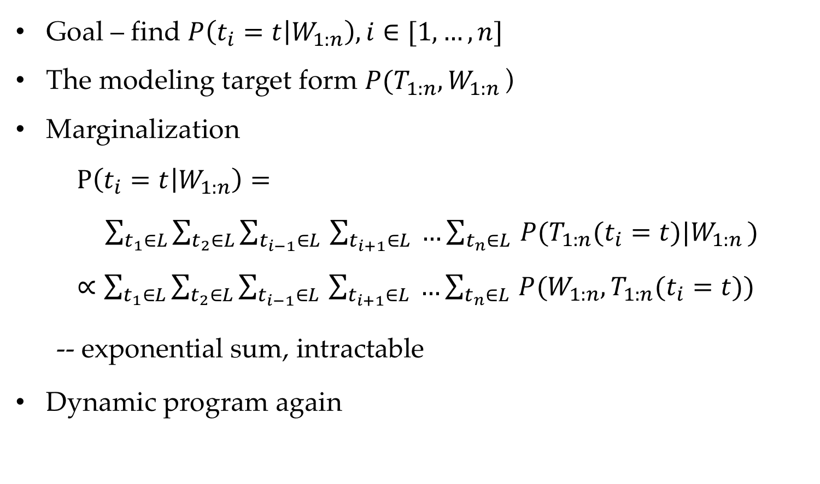
Finding Marginal Probabilities
Goal – find $P\left(t_{i}=t | W_{1:n}\right), i∈[1,…,n]$
The modeling target form $P(T_{1:n},W_{1:n }$)
Marginalization
$P\left(t_{i}=t | W_{1:n}\right)= \sum_{t_{1}∈L}{\sum_{t_{2}∈L}{\sum_{t_{i−1}∈L }{\sum_{t_{i+1}∈L}{ …\sum_{t_{n}∈L }{P(T_{1:n}(t_{i}=t)|W_{1:n })}}}}}$
$∝\sum_{t_{1}∈L}{\sum_{t_{2}∈L}{\sum_{t_{i−1}∈L }{\sum_{t_{i+1}∈L}{ …\sum_{t_{n}∈L }{P(W_{1:n},T_{1:n}(t_{i}=t))}}}}}$
-- exponential sum, intractable
Dynamic program again
Notes:
Intractable exponential

Slide 41
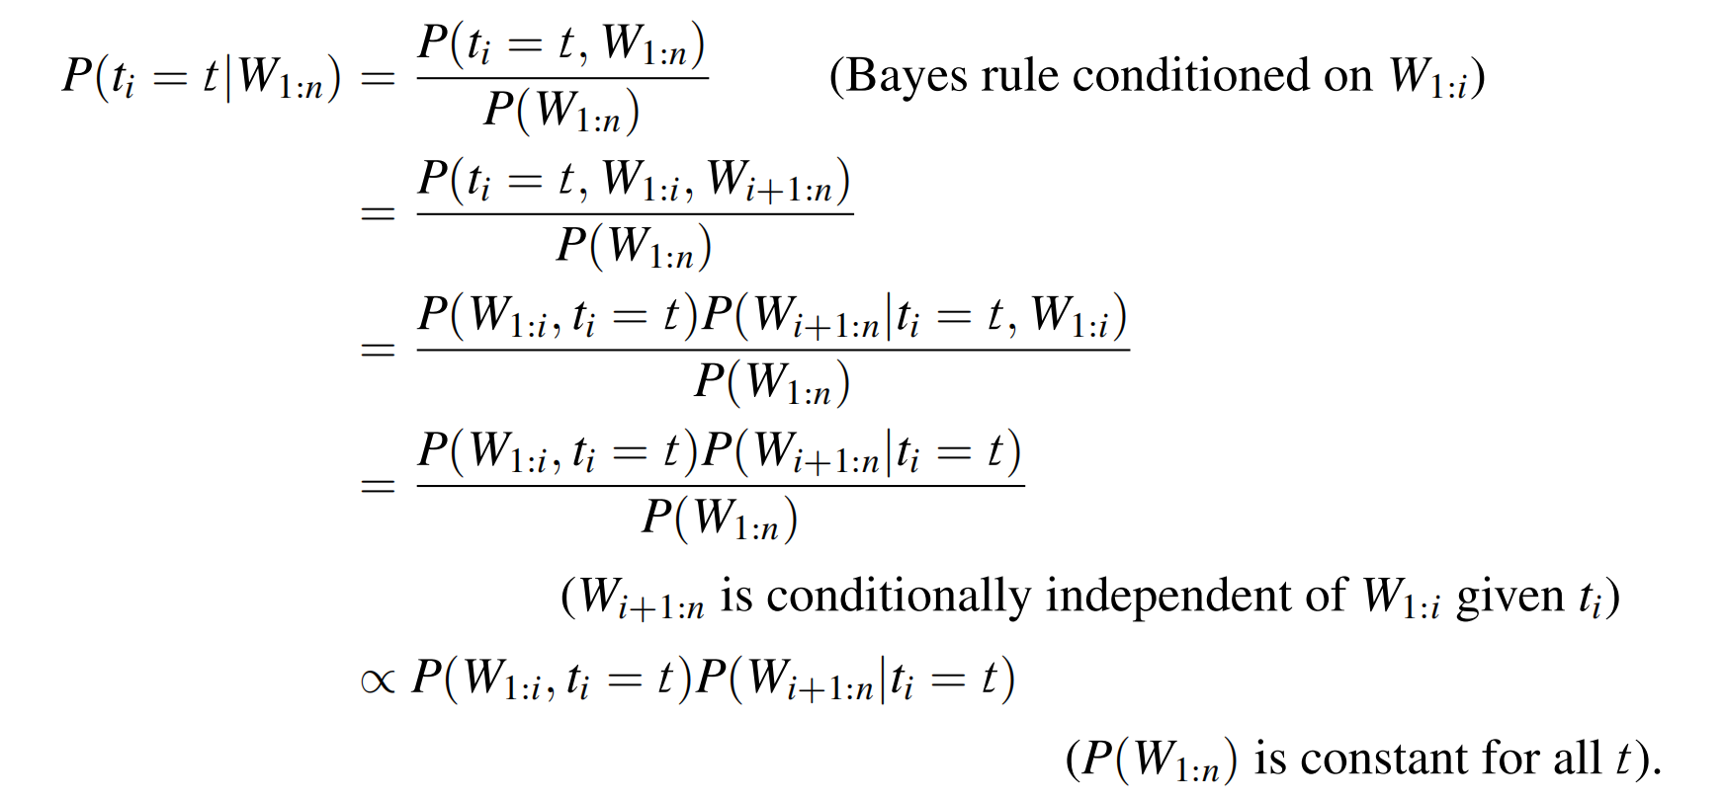
Finding Marginal Probabilities

Slide 42
Finding Marginal Probabilities
Forward algorithm Backward algorithm

Slide 43
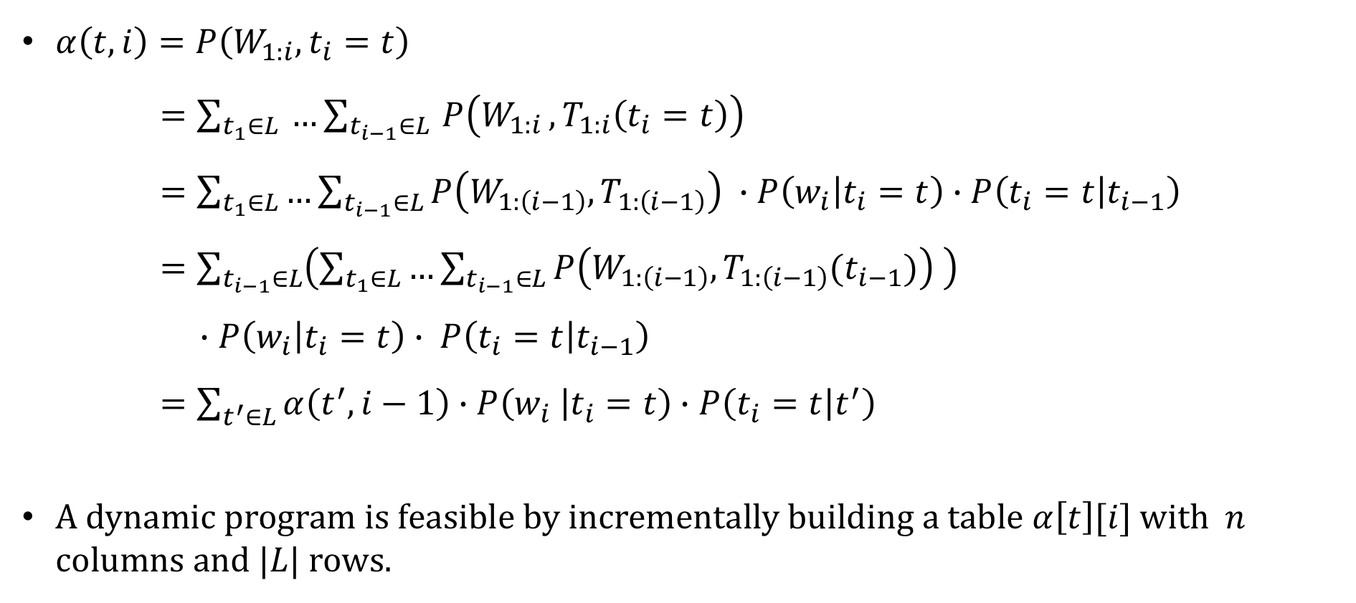
The forward algorithm
$α\left(t,i\right)=P\left(W_{1:i},t_{i}=t\right)$
$=\sum_{t_{1}∈L }{…\sum_{t_{i−1}∈L }{P\left(W_{1:i }, T_{1:i}\left(t_{i}=t\right)\right)}}$
$=\sum_{t_{1}∈L}{…\sum_{t_{i−1}∈L}{P\left(W_{1:\left(i−1\right)},T_{1:\left(i−1\right)}\right) ∙P\left(w_{i} | t_{i}=t\right)∙P\left(t_{i}=t | t_{i−1}\right)}}$
$=\sum_{t_{i−1}∈L}{\left(\sum_{t_{1}∈L}{…\sum_{t_{i−1}∈L}{P\left(W_{1:\left(i−1\right)},T_{1:\left(i−1\right)}(t_{i−1})\right) }}\right)}$
$∙P\left(w_{i} | t_{i}=t\right)∙ P\left(t_{i}=t | t_{i−1}\right)$
$=\sum_{t^{′}∈L}{α\left(t^{′},i−1\right)∙P\left(w_{i} | t_{i}=t\right)∙P\left(t_{i}=t | t^{′}\right)}$
A dynamic program is feasible by incrementally building a table $α\left[t\right][i]$ with $n$ columns and $|L|$ rows.

Slide 44
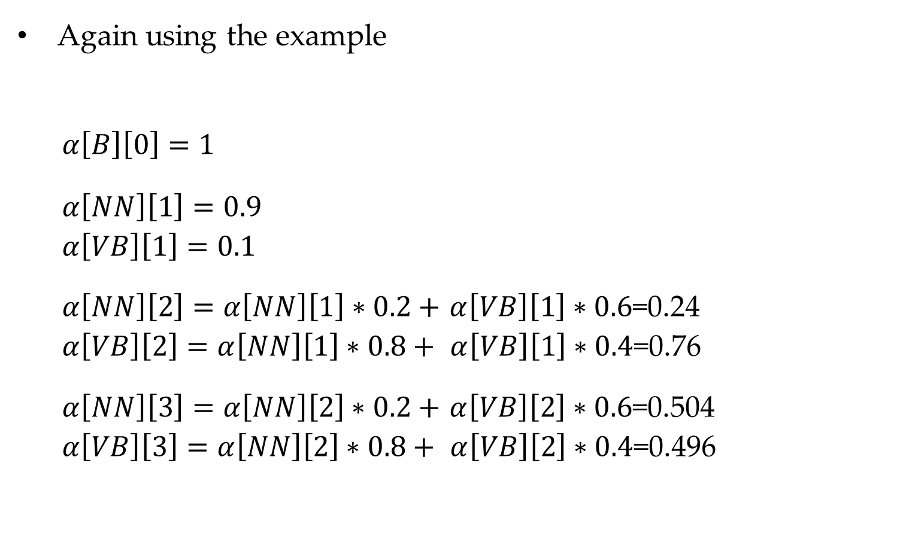
The forward algorithm
People like books
Again using the example
$$α\left[B\right]\left[0\right]=1$$
$$α\left[NN\right]\left[1\right]=0.9$$
$$α\left[VB\right]\left[1\right]=0.1$$
$α\left[NN\right]\left[2\right]=α\left[NN\right]\left[1\right]∗0.2+$ $α\left[VB\right]\left[1\right]∗0.6$=0.24
$$α\left[VB\right]\left[2\right]=α\left[NN\right]\left[1\right]∗0.8+ α\left[VB\right]\left[1\right]∗0.\text{4}\text{=}\text{0.76}$$
$α\left[NN\right]\left[3\right]=$ $α\left[NN\right]\left[2\right]∗0.2+$ $α\left[VB\right]\left[2\right]∗0.6$=0.504
$$α\left[VB\right]\left[3\right]=α\left[NN\right]\left[2\right]∗0.8+ α\left[VB\right]\left[2\right]∗0.\text{4}\text{=0.}\text{496}$$
NN
0.2
NN
0.2
NN
0.9
0.8
0.8
B
0.1
VB
0.6
VB
0.6
VB
0.4
0.4

Slide 45
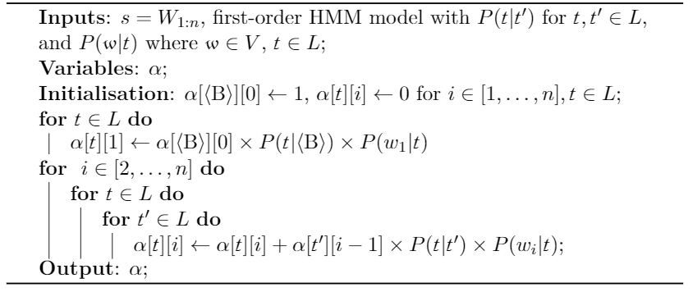
The forward algorithm
<B>: beginning of sentence token
An incremental calculation in the forward direction by using table $α$

Slide 46
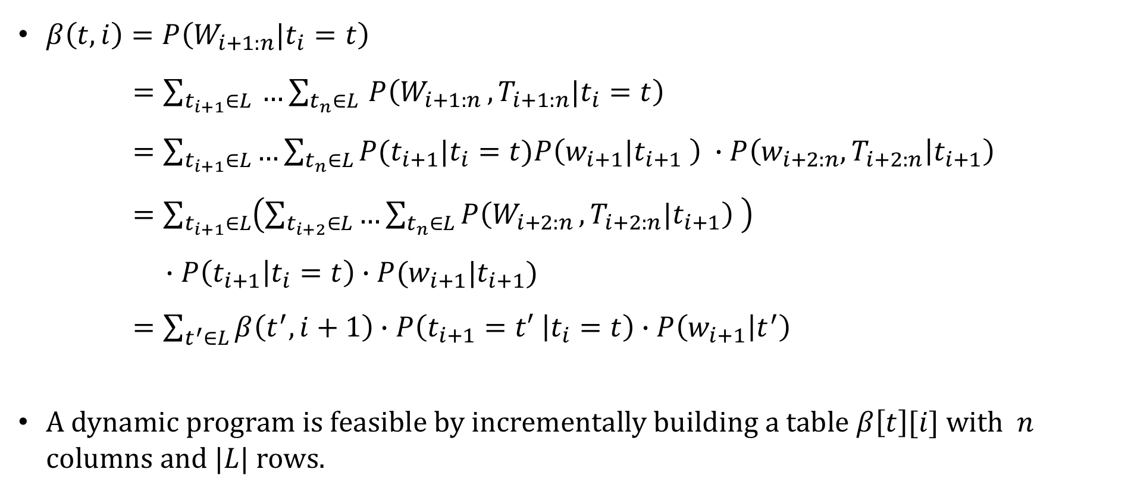
The backward algorithm
$β\left(t,i\right)=P\left(W_{i+1:n}|t_{i}=t\right)$
$=\sum_{t_{i+1}∈L }{…\sum_{t_{n}∈L }{P\left(W_{i+1:n }, T_{i+1:n}|\left.t_{i}=t\right.\right)}}$
$=\sum_{t_{i+1}∈L}{…\sum_{t_{n}∈L}{P(t_{i+1}|t_{i}=t)P\left(w_{i+1}|t_{i+1} \right) ∙P\left(w_{i+2:n},T_{i+2:n} | t_{i+1}\right)}}$
$=\sum_{t_{i+1}∈L}{\left(\sum_{t_{i+2}∈L}{…\sum_{t_{n}∈L}{P\left(W_{i+2:n },T_{i+2:n}|t_{i+1}\right) }}\right)}$
$∙P\left(t_{i+1} | t_{i}=t\right)∙P(w_{i+1}|t_{i+1})$
$=\sum_{t^{′}∈L}{β\left(t^{′},i+1\right)∙P\left(t_{i+1}=t′ | t_{i}=t\right)∙P\left(w_{i+1} | t^{′}\right)}$
A dynamic program is feasible by incrementally building a table $β\left[t\right][i]$ with $n$ columns and $|L|$ rows.

Slide 47
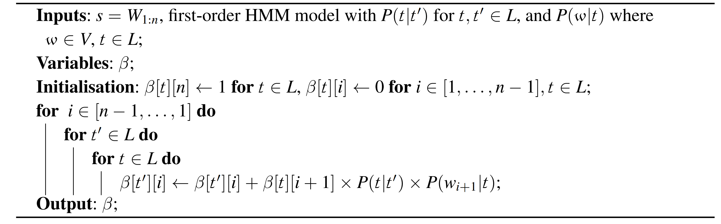
The backward algorithm
An incremental calculation in the backward direction by using table $β$

Slide 48
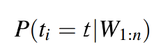
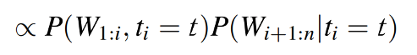
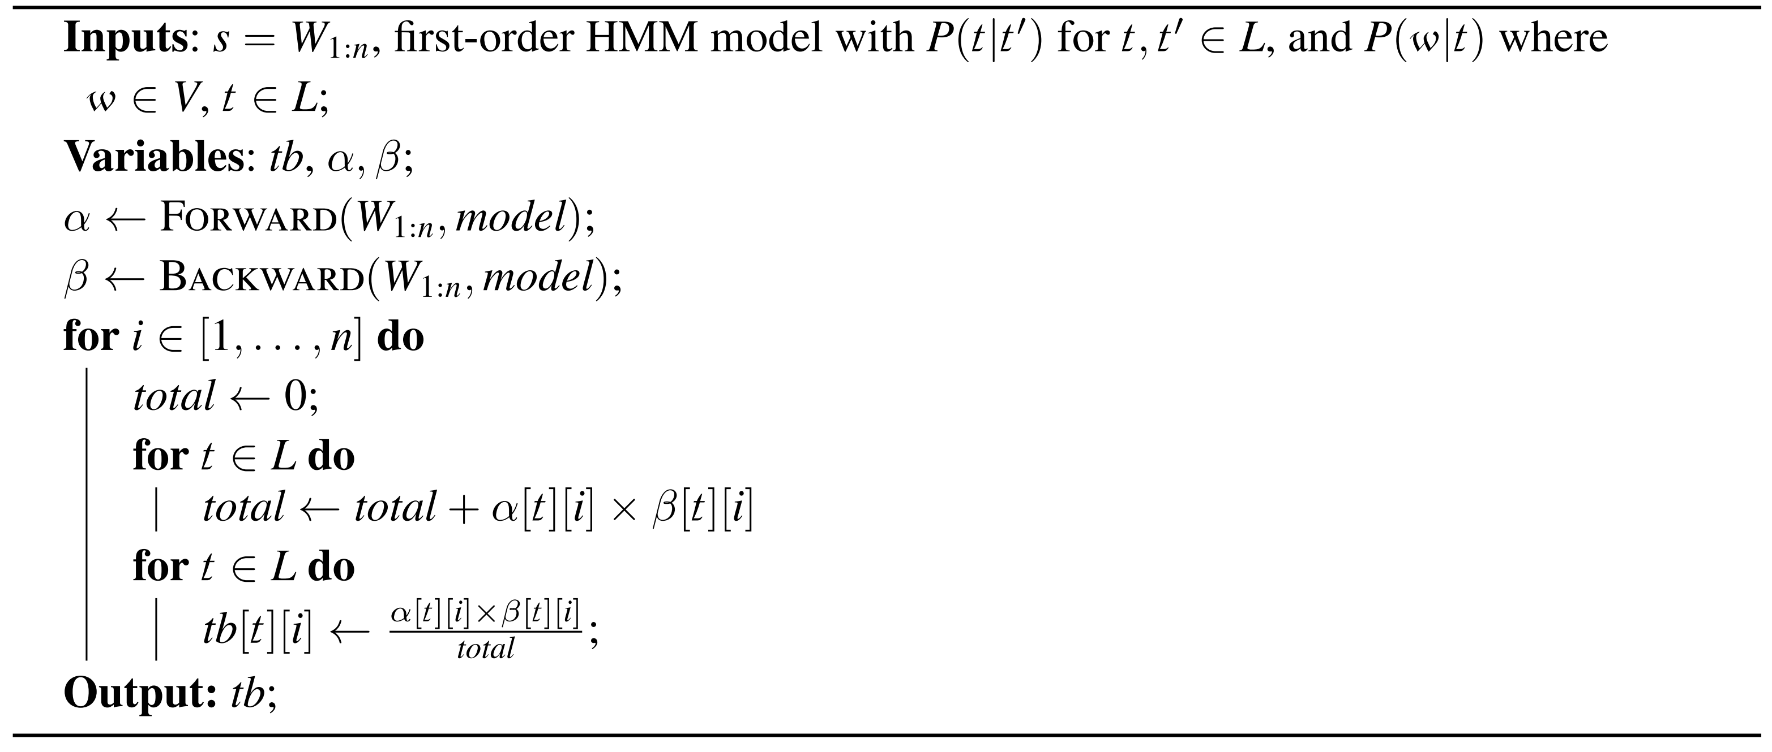
The forward-backward algorithm

Slide 49
Contents
7.1 Sequence Labelling
7.2 Hidden Markov Models
7.2.1 Training Hidden Markov Models
7.2.2 Decoding
7.3 Finding Marginal Probabilities
7.3.1 The Forward- Backward Algorithm
7.4 EM for Unsupervised HMM Training
7.4.1 EM for First-Order HMM

Slide 50
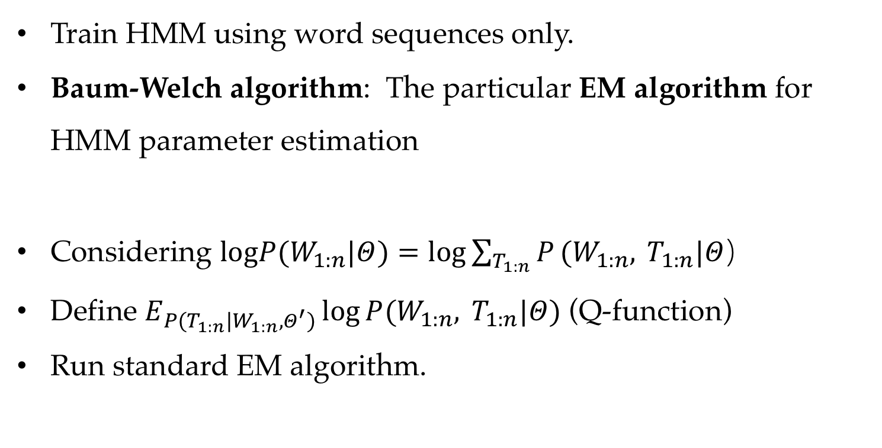
Unsupervised training of HMM
Train HMM using word sequences only.
Baum-Welch algorithm: The particular EM algorithm for HMM parameter estimation
Considering $logP(W_{1:n}|Θ)=log\sum_{T_{1:n}}{P}(W_{1:n}, T_{1:n}|Θ）$
Define $E_{P(T_{1:n}|W_{1:n},Θ^{′})}\log{P(W_{1:n}, T_{1:n}|Θ)}$ (Q-function)
Run standard EM algorithm.

Slide 51
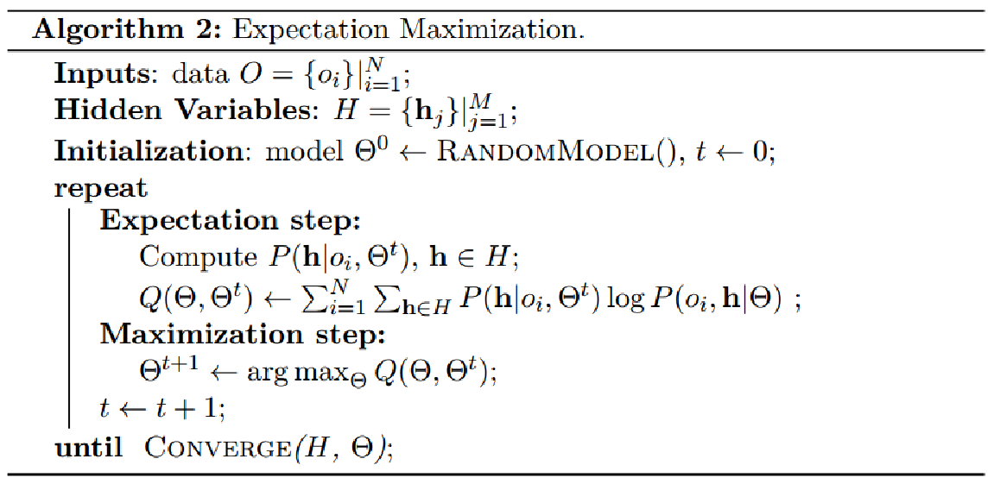
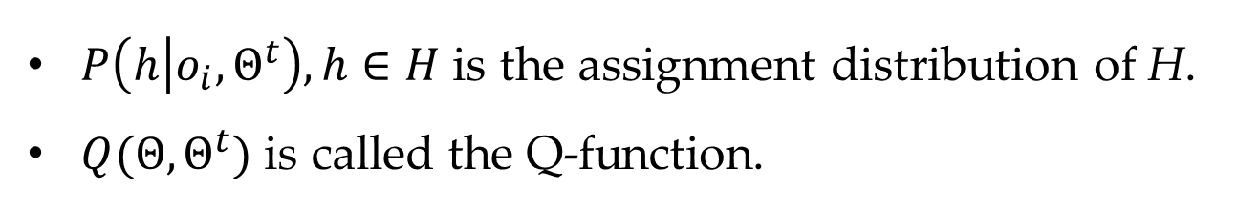
Recall EM
EM
$P\left(h | o_{i},Θ^{t}\right),h∈H$ is the assignment distribution of H.
$Q(Θ,Θ^{t})$ is called the Q-function.

Slide 52




Expectation step
Parameterize the expectation function $Q(Θ,Θ^{′})$
$$Q(Θ,Θ^{′})=\sum_{T_{1:n}}{P}( T_{1:n}|W_{1:n},Θ^{′})logP(W_{1:n},T_{1:n}|Θ)\text{,}$$
$$=\sum_{T_{1:n}}{P}( T_{1:n}|W_{1:n},Θ^{′})log(\prod_{i=1}^{n}{P}\left(t_{i} | t_{i−1}\right)P\left(w_{i} | t_{i}\right))$$
$$=\sum_{T_{1:n}}{P}( T_{1:n}|W_{1:n},Θ^{′})\sum_{i=1}^{n}{(}logP(w_{i}|t_{i})+logP(t_{i}|t_{i−1}))$$
$$=\sum_{i=1}^{n}{(}\sum_{w}{\sum_{t}{\log{P(w|t)}}}\sum_{T_{1:n}}{P}(T_{1:n}|W_{1:n},Θ^{′})δ(t_{i},t)δ(w_{i},w))$$
$$+\sum_{i=1}^{n}{(}\sum_{t^{′}}{\sum_{t}{\log{P(t|t′)}}}\sum_{T_{1:n}}{P}(T_{1:n}|W_{1:n},Θ^{′})δ(t_{i−1},t^{′})δ(t_{i},t))$$

Slide 53




Expectation step
Let $γ_{i}(t)=\sum_{T_{1:n}}{P}(T_{1:n}|W_{1:n},Θ^{′})δ(t_{i},t)$ and
${ ξ}_{i}(t^{′},t)=\sum_{T_{1:n}}{P}(T_{1:n}|W_{1:n},Θ^{′})δ(t_{i−1},t^{′})δ(t_{i},t)$, both can be
computed efficiently.
$$γ_{i}(t)=\frac{\left.α(i,t)β(i,t\right)}{\left.\sum_{t^{′}∈L}{α}(i,t^{′})β(i,t^{′}\right)},$$
$$ξ_{i}(t^{′},t)=\frac{\left.α(i−1,t^{′})P(t|t^{′},Θ^{′})P(w_{i}|t,Θ^{′})β(i,t\right)}{\left.\sum_{u∈L}{α}(i,u)β(i,u\right)}$$
$$Q\left(Θ,Θ^{′}\right)=\sum_{i=1}^{n}{(}\sum_{w∈V}{\sum_{t∈L}{\log{P\left(w | t\right)δ\left(w_{i},w\right)γ_{i}\left(t\right) }}}+\sum_{i=1}^{n}{(}\sum_{t^{′}∈ L}{\sum_{t∈L}{\log{P(t|t^{′})ξ_{i}(t^{′},t)}}}$$

Slide 54




Expectation step
Therefore,
$Q\left(Θ,Θ^{′}\right)=\sum_{i=1}^{n}{\sum_{w}{\sum_{t}{\log{P\left(w | t\right)δ\left(w_{i},w\right)γ_{i}\left(t\right)}}} }$
$+ \sum_{i=1}^{n}{\sum_{t^{′}}{\sum_{t}{\log{P\left(t | t^{′}\right)ξ_{i}\left(t^{′},t\right)}}}}$
$=\sum_{w}{\sum_{t}{\log{P\left(w | t\right)}\sum_{i=1}^{n}{δ\left(w_{i},w\right)γ_{i}\left(t\right)}}}$
$+\sum_{t^{′}}{\sum_{t}{\log{P\left(t | t^{′}\right)}\sum_{i=1}^{n}{ξ_{i}\left(t^{′},t\right)}}}$

Slide 55









Maximization step
Use Lagrange multipliers to find the constrained optimum.
$Λ(Θ) =\sum_{w}{\sum_{t}{log}}P(w|t)\sum_{i=1}^{n}{δ}(w_{i},w)γ_{i}(t)$
from $Q(Θ,Θ′)$
$+\sum_{t^{′}}{\sum_{t}{log}}P(t|t^{′})\sum_{i=1}^{n}{ξ_{i}}(t^{′},t)$
$\sum_{w}{P\left(w | t\right)=1}$, $\sum_{t}{P\left(t | t′\right)=1}$
$+\sum_{t}{(λ_{t}^{1}}(1−\sum_{w}{P}(w|t))+\sum_{t^{′}}{λ_{t^{′}}^{2}}\left(1−\sum_{t}{P}\left(t | t^{′}\right))\right)$
The partial derivative of $π(Θ,Λ)$with respect to $\left.P(w|t\right)$
$$\frac{\left.∂Λ(Θ\right)}{\left.∂P(w|t\right)} =\frac{\left.\sum_{i=1}^{n}{δ}(w_{i},w)γ_{i}(t\right)}{\left.P(w|t\right)}−λ_{t}^{1}$$
$$P\left(w | t\right)=\frac{\left.\sum_{i=1}^{n}{δ}(w_{i},w)γ_{i}(t\right)}{λ_{t}^{1}}=\frac{\left.\sum_{i=1}^{n}{δ}(w_{i},w)γ_{i}(t\right)}{\left.\sum_{i=1}^{n}{γ_{i}}(t\right)}=\sum_{i=1}^{n}{\frac{δ\left(w_{i},w\right)γ_{i}\left(t\right)}{γ_{i}\left(t\right)}}$$
Let $\frac{\left.∂Λ(Θ\right)}{\left.∂P(w|t\right)} =$0,
Similarly,
$$P\left(t | t^{′}\right)=\frac{\left.\sum_{i=1}^{n}{ξ_{i}}(t^{′},t\right)}{\left.\sum_{u}{\sum_{i=1}^{n}{ξ_{i}}}(t^{′},u\right)}=\frac{\left.\sum_{i=1}^{n}{ξ_{i}}(t^{′},t\right)}{\left.\sum_{i=1}^{n}{\sum_{u}{ξ_{i}}}(t^{′},u\right)}=\frac{\left.\sum_{i=1}^{n}{ξ_{i}}(t^{′},t\right)}{\left.\sum_{i=1}^{n}{γ_{i}}(t^{′}\right)}=\sum_{i=1}^{n}{\frac{ξ_{i}\left(t^{′},t\right)}{γ_{i}(t′)}}$$

Slide 56


Maximization step
With N observations
$$P\left(w | t\right) =\frac{\sum_{k=1}^{N}{\sum_{i=1}^{n_{k}}{δ}\left(w_{i}^{k},w\right)γ_{i}^{k}\left(t\right)}}{\sum_{k=1}^{N}{\sum_{i=1}^{n_{k}}{γ_{i}^{k}}\left(t\right)}}=\sum_{k=1}^{N}{\sum_{i=1}^{n_{k}}{\frac{δ\left(w_{i}^{k},w\right)γ_{i}^{k}\left(t\right)}{γ_{i}^{k}\left(t\right)}}}$$
$P\left(t | t^{′}\right)=\frac{\sum_{k=1}^{N}{\sum_{i=1}^{n_{k}}{ξ_{i}^{k}\left(t^{′},t\right)}}}{\sum_{k=1}^{N}{\sum_{i=1}^{n_{k}}{γ_{i}^{k}\left(t^{′}\right)}}}=$ $\sum_{k=1}^{N}{\sum_{i=1}^{n_{k}}{\frac{ξ_{i}^{k}\left(t^{′},t\right)}{γ_{i}^{k}\left(t^{′}\right)}}}$

Slide 57




Baum-Welch algorithm
Calculate $γ_{i}(t)$ and $ξ_{i}(t^{′},t)$
Calculate $P(w|t)$
Calculate $P(t|t^{′})$

Slide 58
Summary
Hidden Markov models (HMM), first order HMMs, second order HMMs
Viterbi decoding algorithms both for first order HMMs and second order HMMs
Forward algorithms, backward algorithms, forward-backward algorithms both for first order HMMs and second order HMMs
EM algorithms for HMMs

